Slide 1
Performance Estimation, Testing, and Control of Cyber-Physical Systems Employing Non-Ideal Communications Networks
Richard Candell
PhD Thesis
28 September 2020

Slide 2

About Me
Richard Candell has over twenty years of experience in telecommunications system engineering with extensive experience in the design and evaluation of wireless communications systems. Mr. Candell spent twelve years developing, testing, and deploying secure wireless technologies for commercial and defense applications. He served as the lead systems engineer in developing spread spectrum interference cancellation and performance evaluation strategies for satellite ground stations and mobile phased array beam steering transceivers. He holds patents in successive interference cancellation and transmission burst detection applied to spread-spectrum satellite communications signals. Mr. Candell holds a BS and MS degree in Electrical Engineering from The University of Memphis. He joined the NIST in 2014. His current research interests include the performance impacts of wireless networks on industrial sensing and actuated control applications for mobile robotic, manufacturing, and safety applications. Mr. Candell was the primary contributing author of the Guide to Industrial Wireless Systems Deployments (NIST AMS 300-4) and the chair of the NIST Industrial Wireless System technical working group.
Notes:
Rick Candell, MSEE
12 years: Tactical Radio Systems and SATCOM
Real-time Embedded, radio systems, SDR
Early career: manufacturing of wood products
Current role: Researcher at NIST
Project Leader: Wireless Platforms for Smart Manufacturing
With NIST since Sept. 2013
Other Roles: Cybersecurity Testbed
Interests:
CPS impacts of lossy networks
Uses of AI in manufacturing and IWNs
Wireless propagation and recreation of RF environments

Slide 3
The NIST Industrial Wireless Project – A Context for Research
Performance Estimation, Testing, and Control of Cyber-Physical Systems Employing Non-Ideal Communications Networks
Thesis Presentation 28 September 2020
Richard Candell

Slide 4

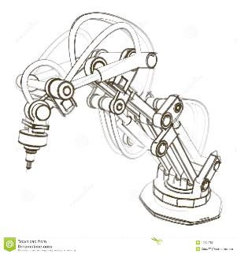

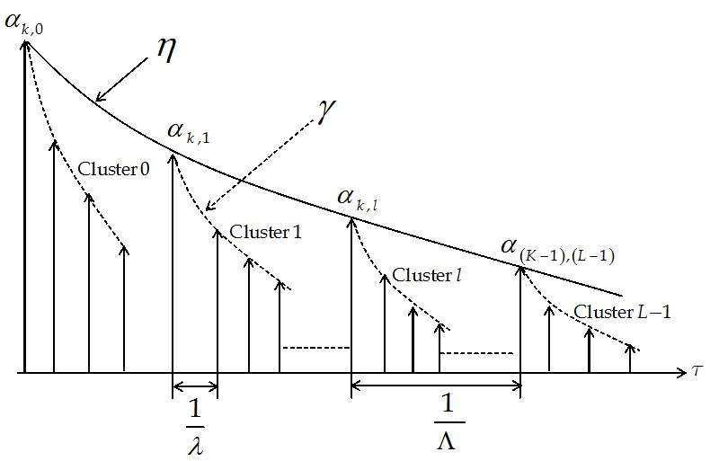
Historical Approach
Field Data
Models
Interference Models
Propagation Models
Experiments
Testbed
Guidelines
Brown field control
Channel Models
Increase data
More Reliable
Live Factories
Improve Safety
Precision Measurements
Meetings
Conferences
Manufacturing Models
Simulations
Best Practices
Spur Innovation
Spectrum Sensing
Advanced control solutions
Notes:
It doesn’t make sense to deliver guidelines without considering the factory performance under different scenarios.
MY APPROACH: Combine my research at NIST with PhD research

Slide 5


















Collaborators: Past and Present
Notes:
Contacts:
All collaborators share a common interest in industrial wireless. They will all participate and respond to our guidelines document.
Honeywell – Phillip Ng (new contact, very interested in outcomes)
Boeing - Al Salour, Bala Chidambaram, Mark Vanhorne ()
Ford - Mike Read, Eric Newman
Chevron – Brent Aube, Stacie Smith, Greg Laframboise (retired)
Phoenix Contact – Justin Shade, Lee Boice
Honeywell: Phillip Ng (new contact)
Yokagawa – Toshi Hasegawa
WSSC – Jacob Brodsky, review of our guidelines
PiControl Solutions – Steve Howes (control design solutions for wireless)
IEEE – Various, Victor Huang (IMS), Kim Mann (IES), Pat Kinney (IEEE/DETNET)
ISA – Jay Werb, Sterling Rooke, Herman Storey
UMD – Shuvra Bhattacharya
Michigan – Wayne Stark
Delware - Chien-Chung Shen
Ultra-3eTI – John Fosssaceca (he left for ARL)

Slide 6
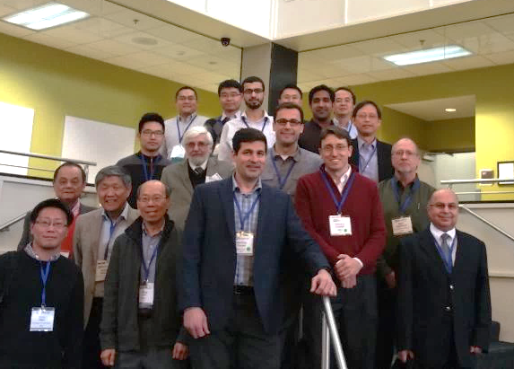
Technical Working Group Established
IEEE Sensors Applications Symposium
Established March 13, 2017
Key Participants at the time
Boeing
ABB
IEEE
ISA
NIST

Slide 7
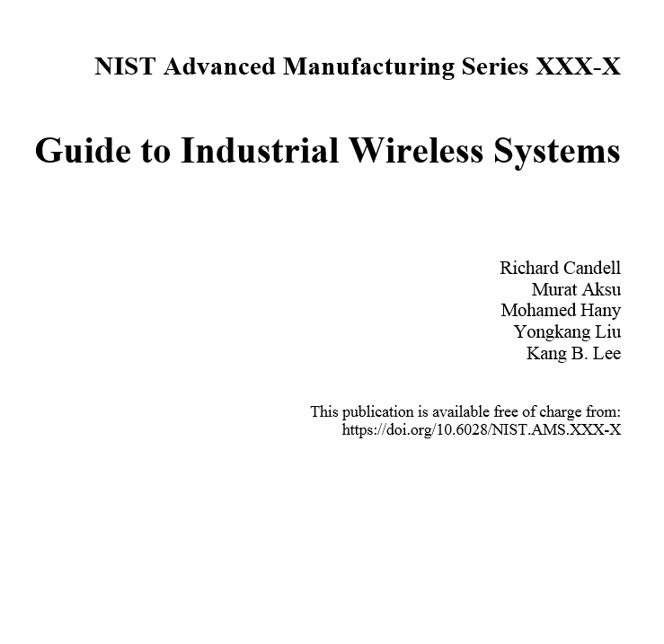
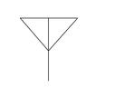

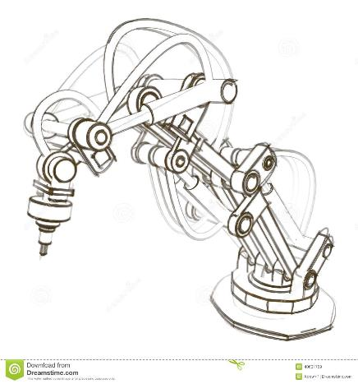

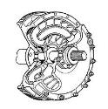
Current Project Objectives: Two Tracks
Track 1: Provide Guidance to Industry Deliver comprehensive, measurement science-based guidelines in the selection, deployment, and optimization of the wireless technologies in specific manufacturing environments.
Track 2: Address Emerging Needs Conduct research that advances the state of technology of wireless-based automation systems in which time, reliability, energy, and scale are joint considerations.

Slide 8
The NIST Industrial Wireless Testbed
Performance Estimation, Testing, and Control of Cyber-Physical Systems Employing Non-Ideal Communications Networks
Thesis Presentation 28 September 2020
Richard Candell

Slide 9
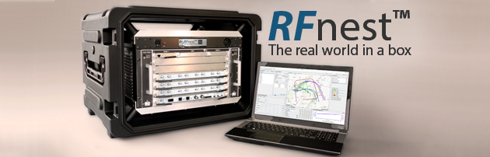
Key Capability: RF Channel Emulator
Transmission Delay
Path loss
Multipath
Fading
Interference
Mobility Radios
Mobile Surroundings
Recreates the Factory’s Radio Environment in the Lab

Slide 10
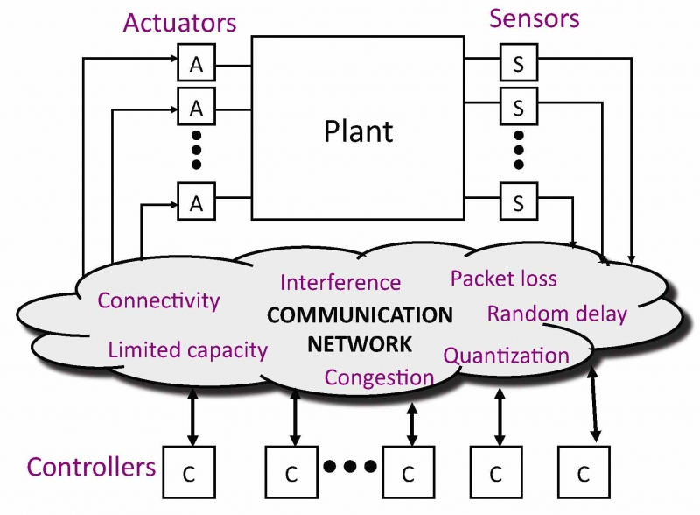
Recreating the Factory RF Environment in the Lab
Radio Environment
Metal, Conduits, Pipes
Absorptives
Path loss & reverb.
Machine Noise
“Friendly” interference
Jamming (security)
RF Channel Emulator
Possible Focus Areas
Improved wireless standards
Wireless Reliability
Better Control strategies
Interference cancellation
Time Synchronization

Slide 11
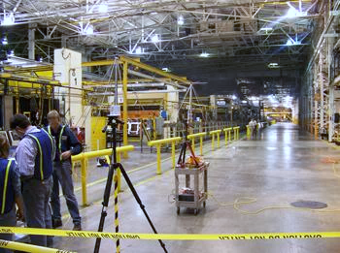
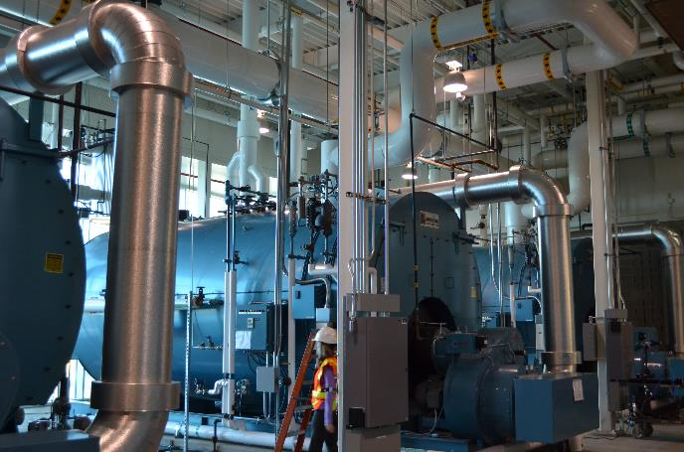
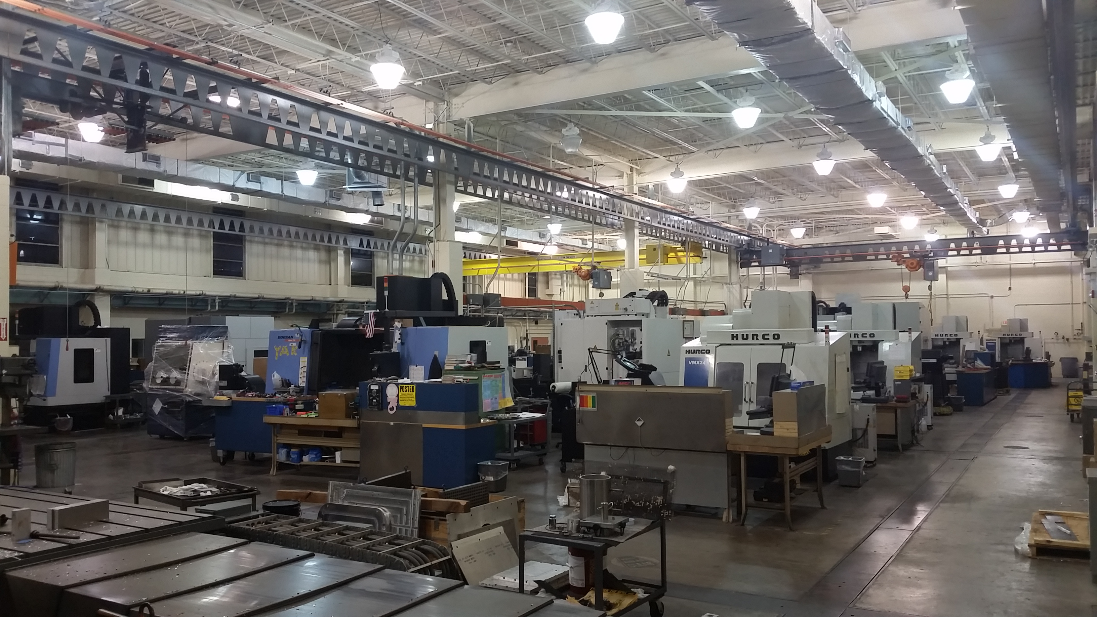
Measurement Campaigns
Auto Factory
Boulder Steam Plant
Machine Shop

Slide 12
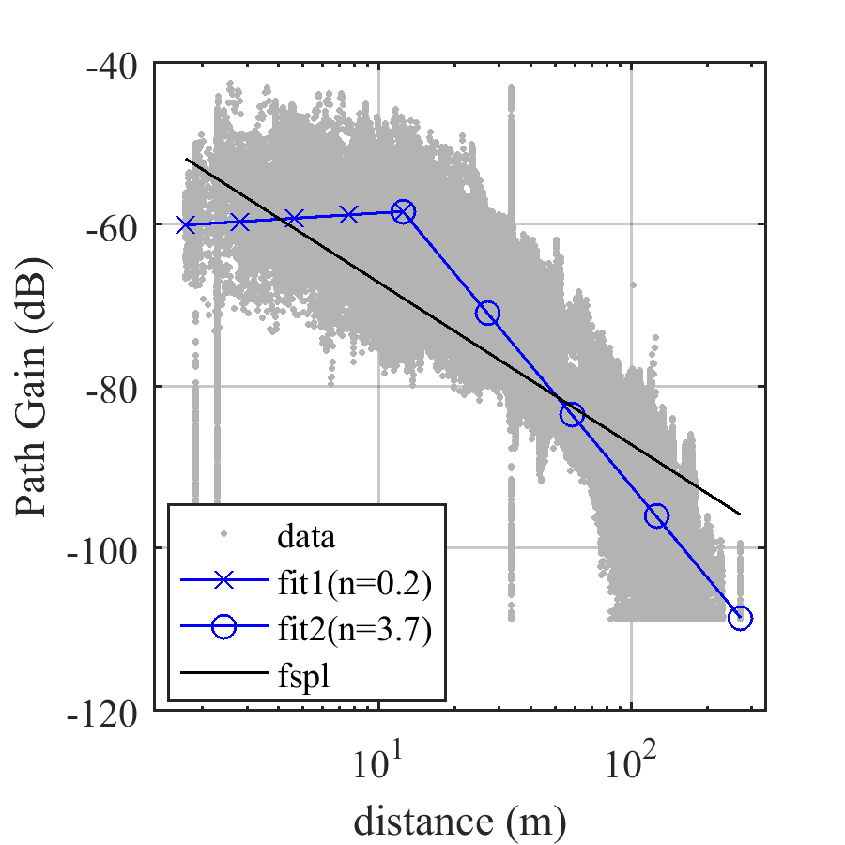
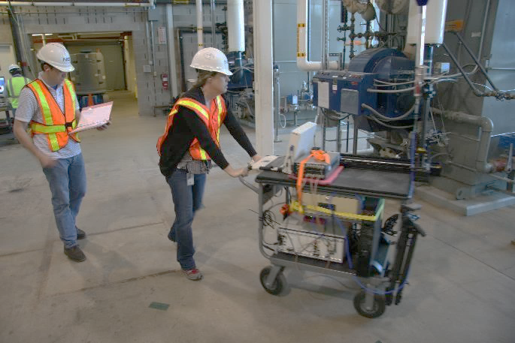
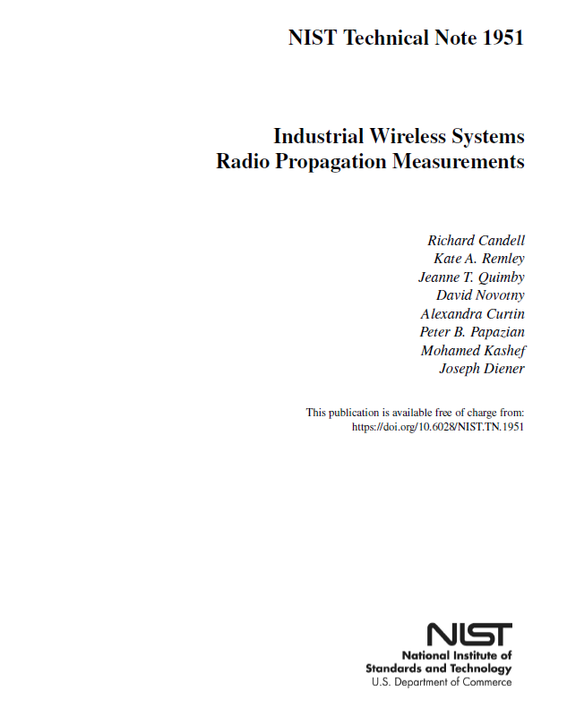
Mobile Cart-based Measurements
Candell, R., Remley, K. A., Quimby, J. T., Novotny, D., Curtin, A., Papazian, P. B., Kashef, M., & Diener, J. (2017). Industrial wireless systems radio propagation measurements. https://doi.org/10.6028/nist.tn.1951

Slide 13
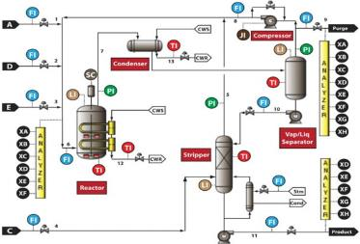
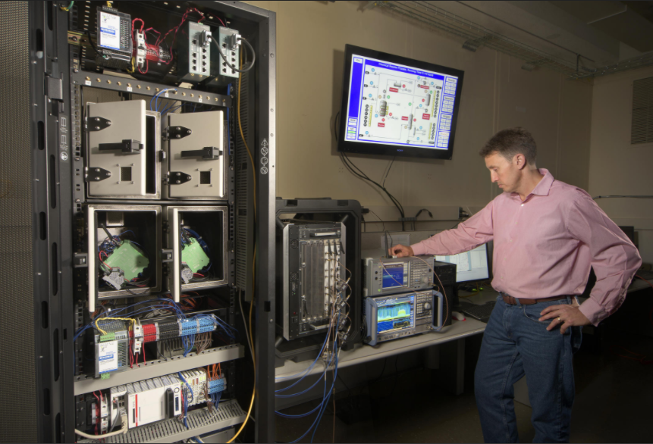
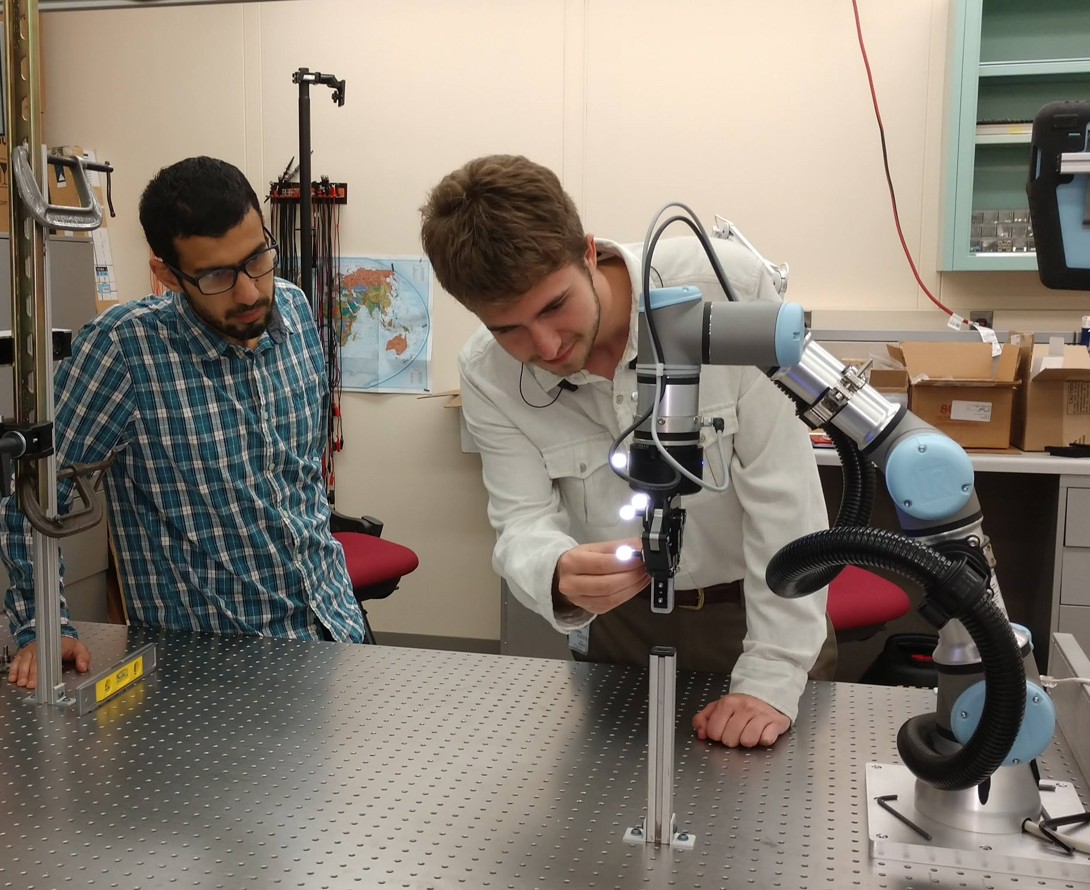
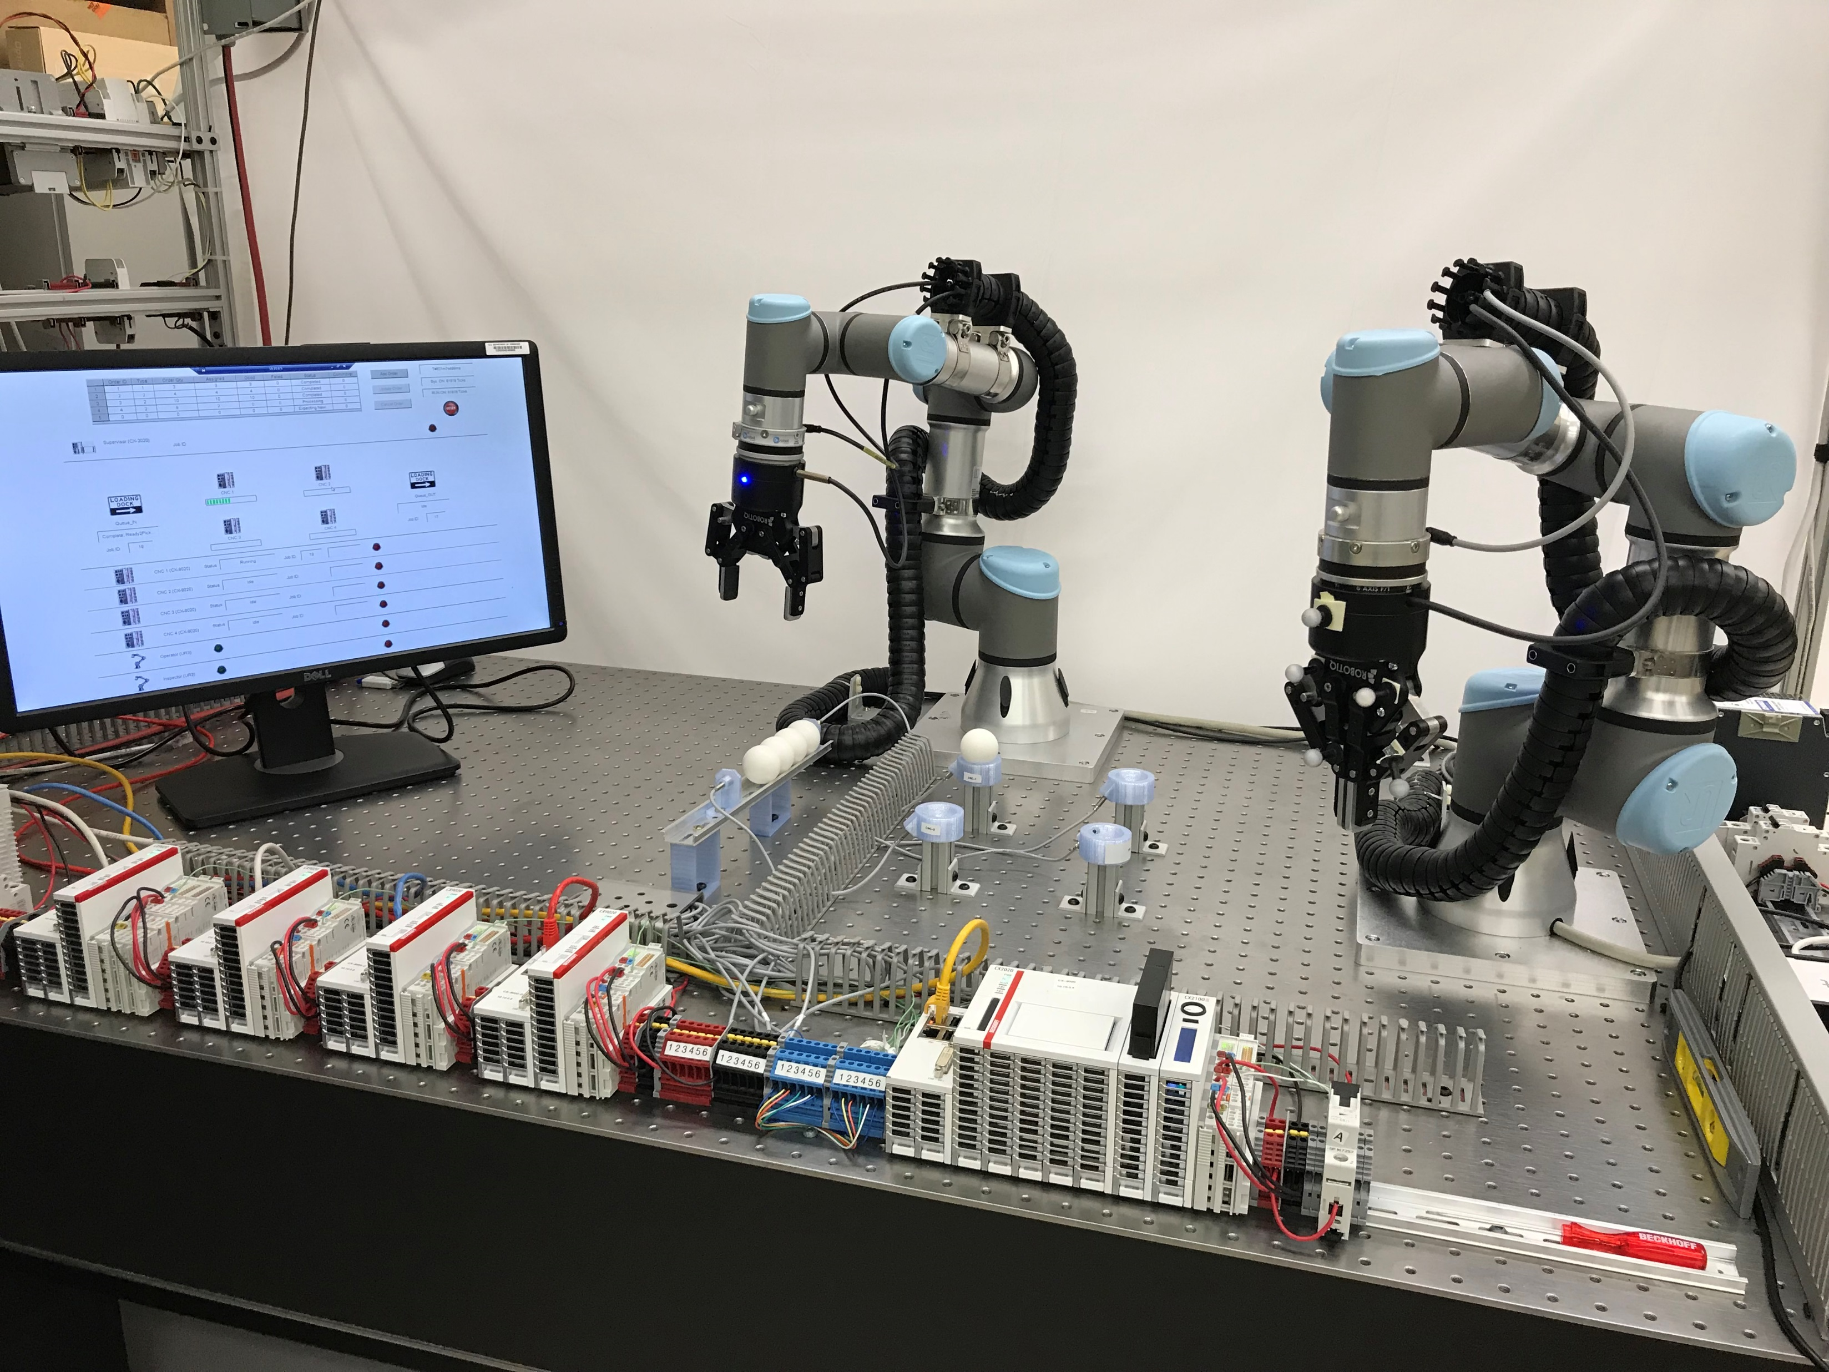
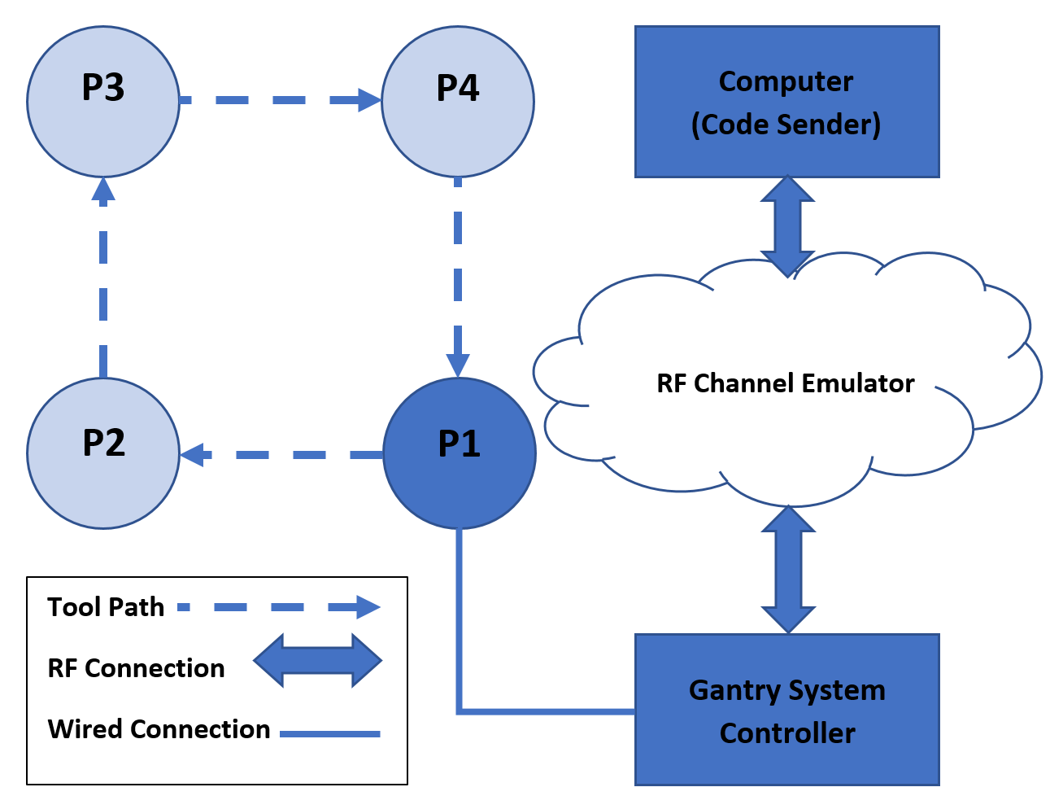
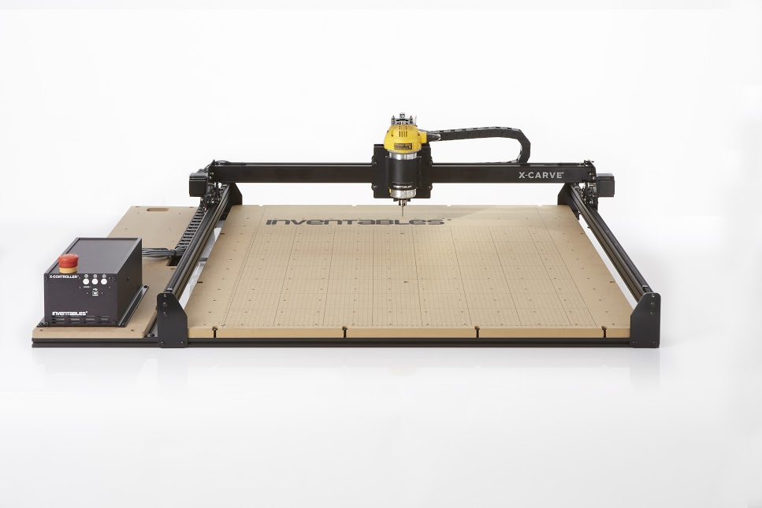
Past Testbed Incarnations
(1)
1 - NIST - Tennessee Eastman chemical plant
2 - NIST - 3D gantry system
* 3 - NIST - Force seeking apparatus
* 4 - NIST - Dual-robot machine tending with inspection
(2)
(3)
(4)

Slide 14
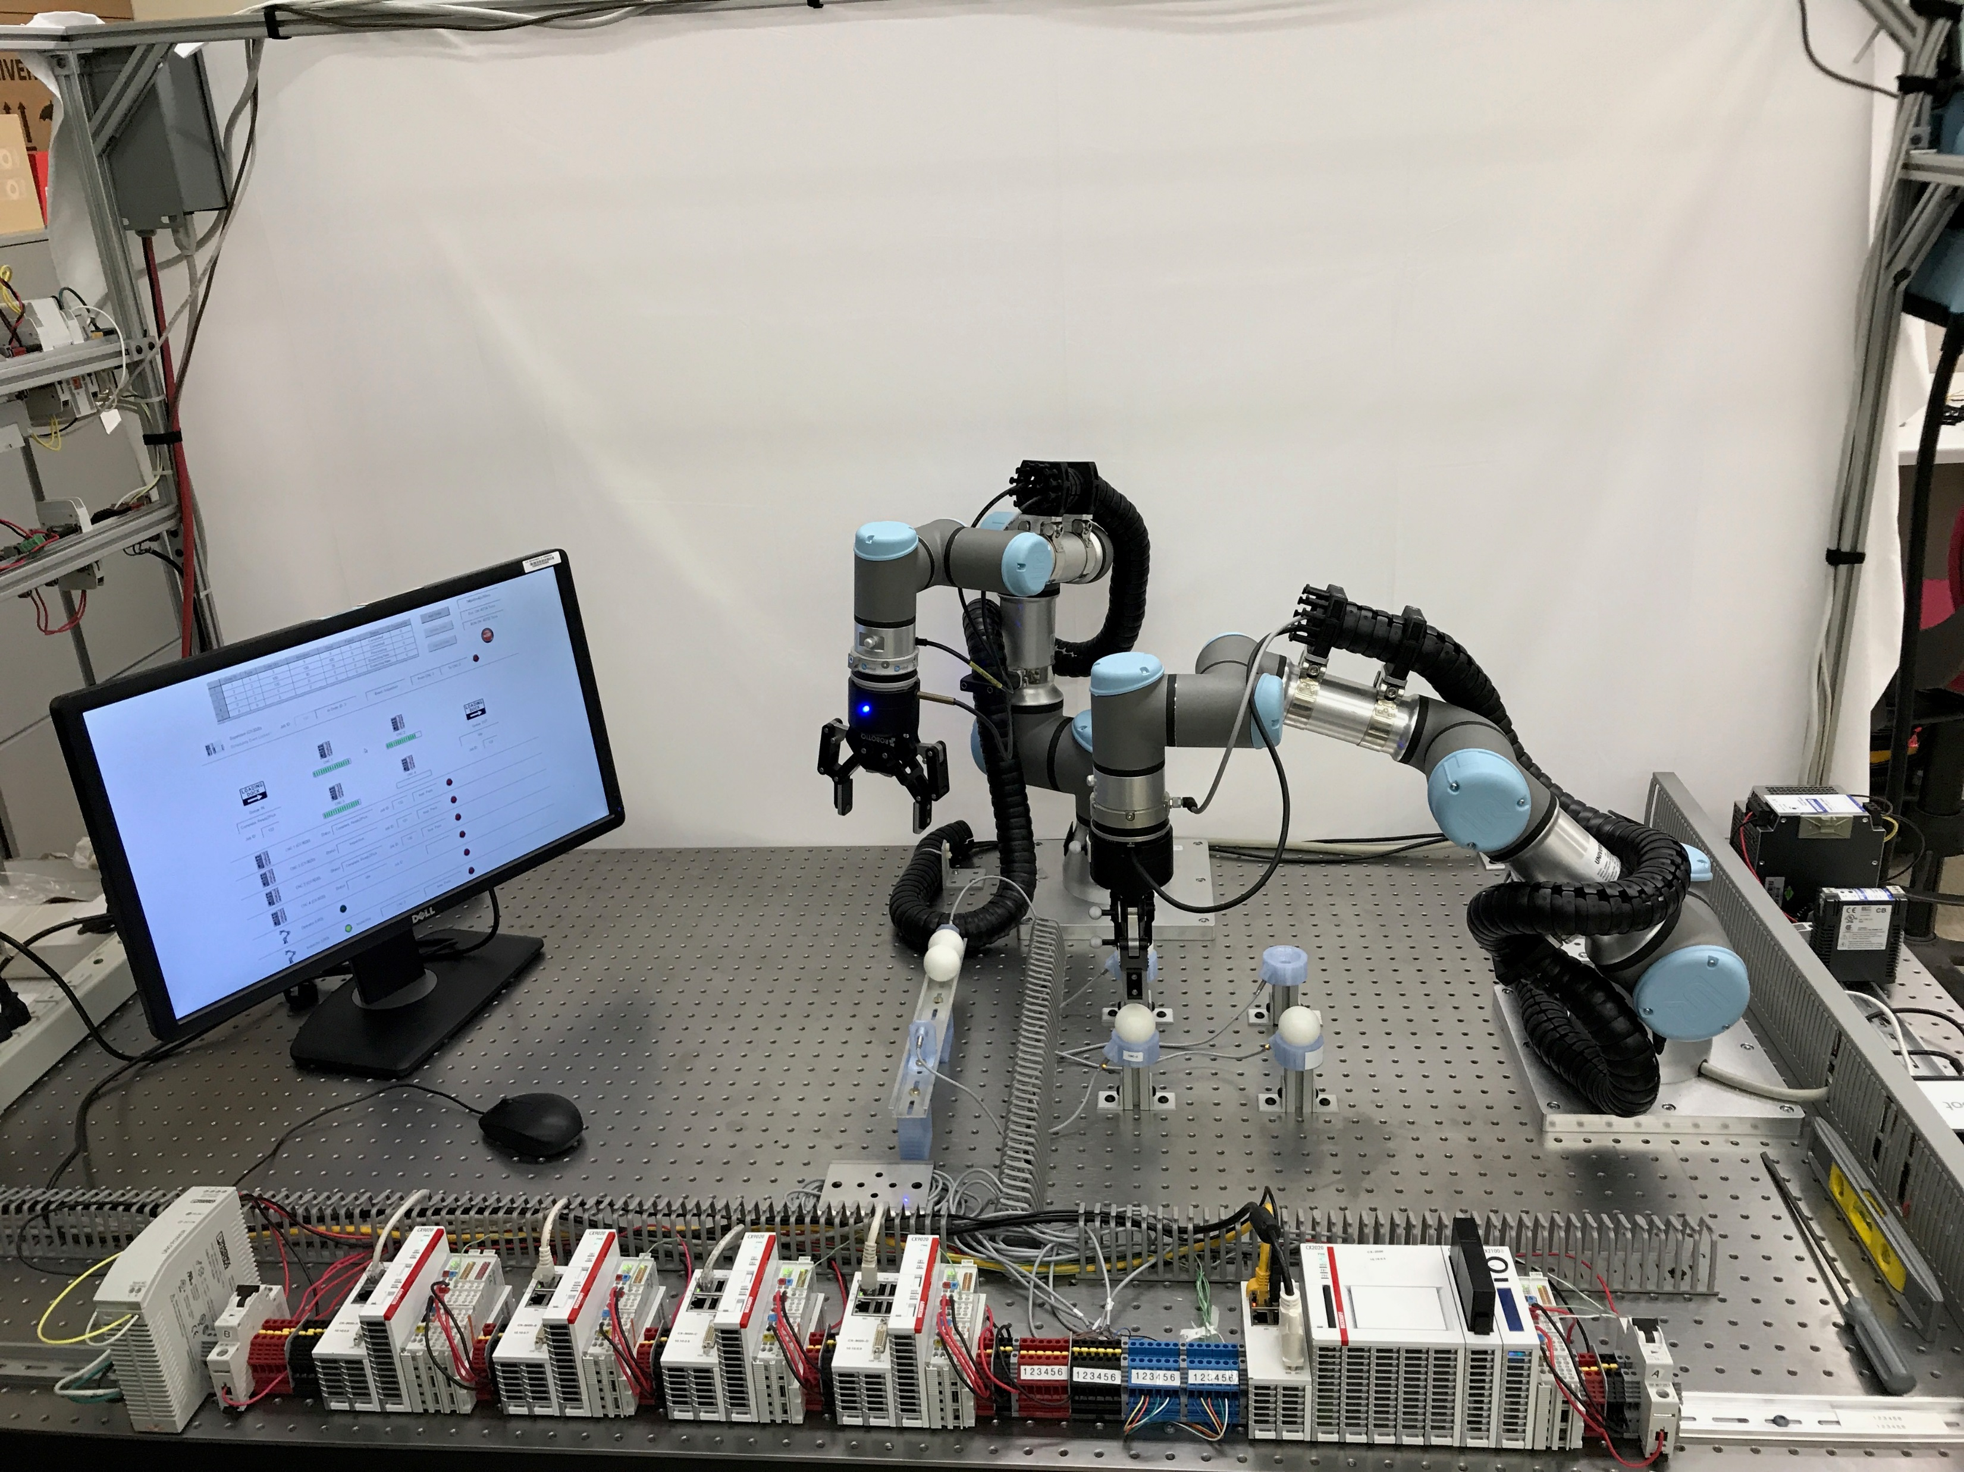
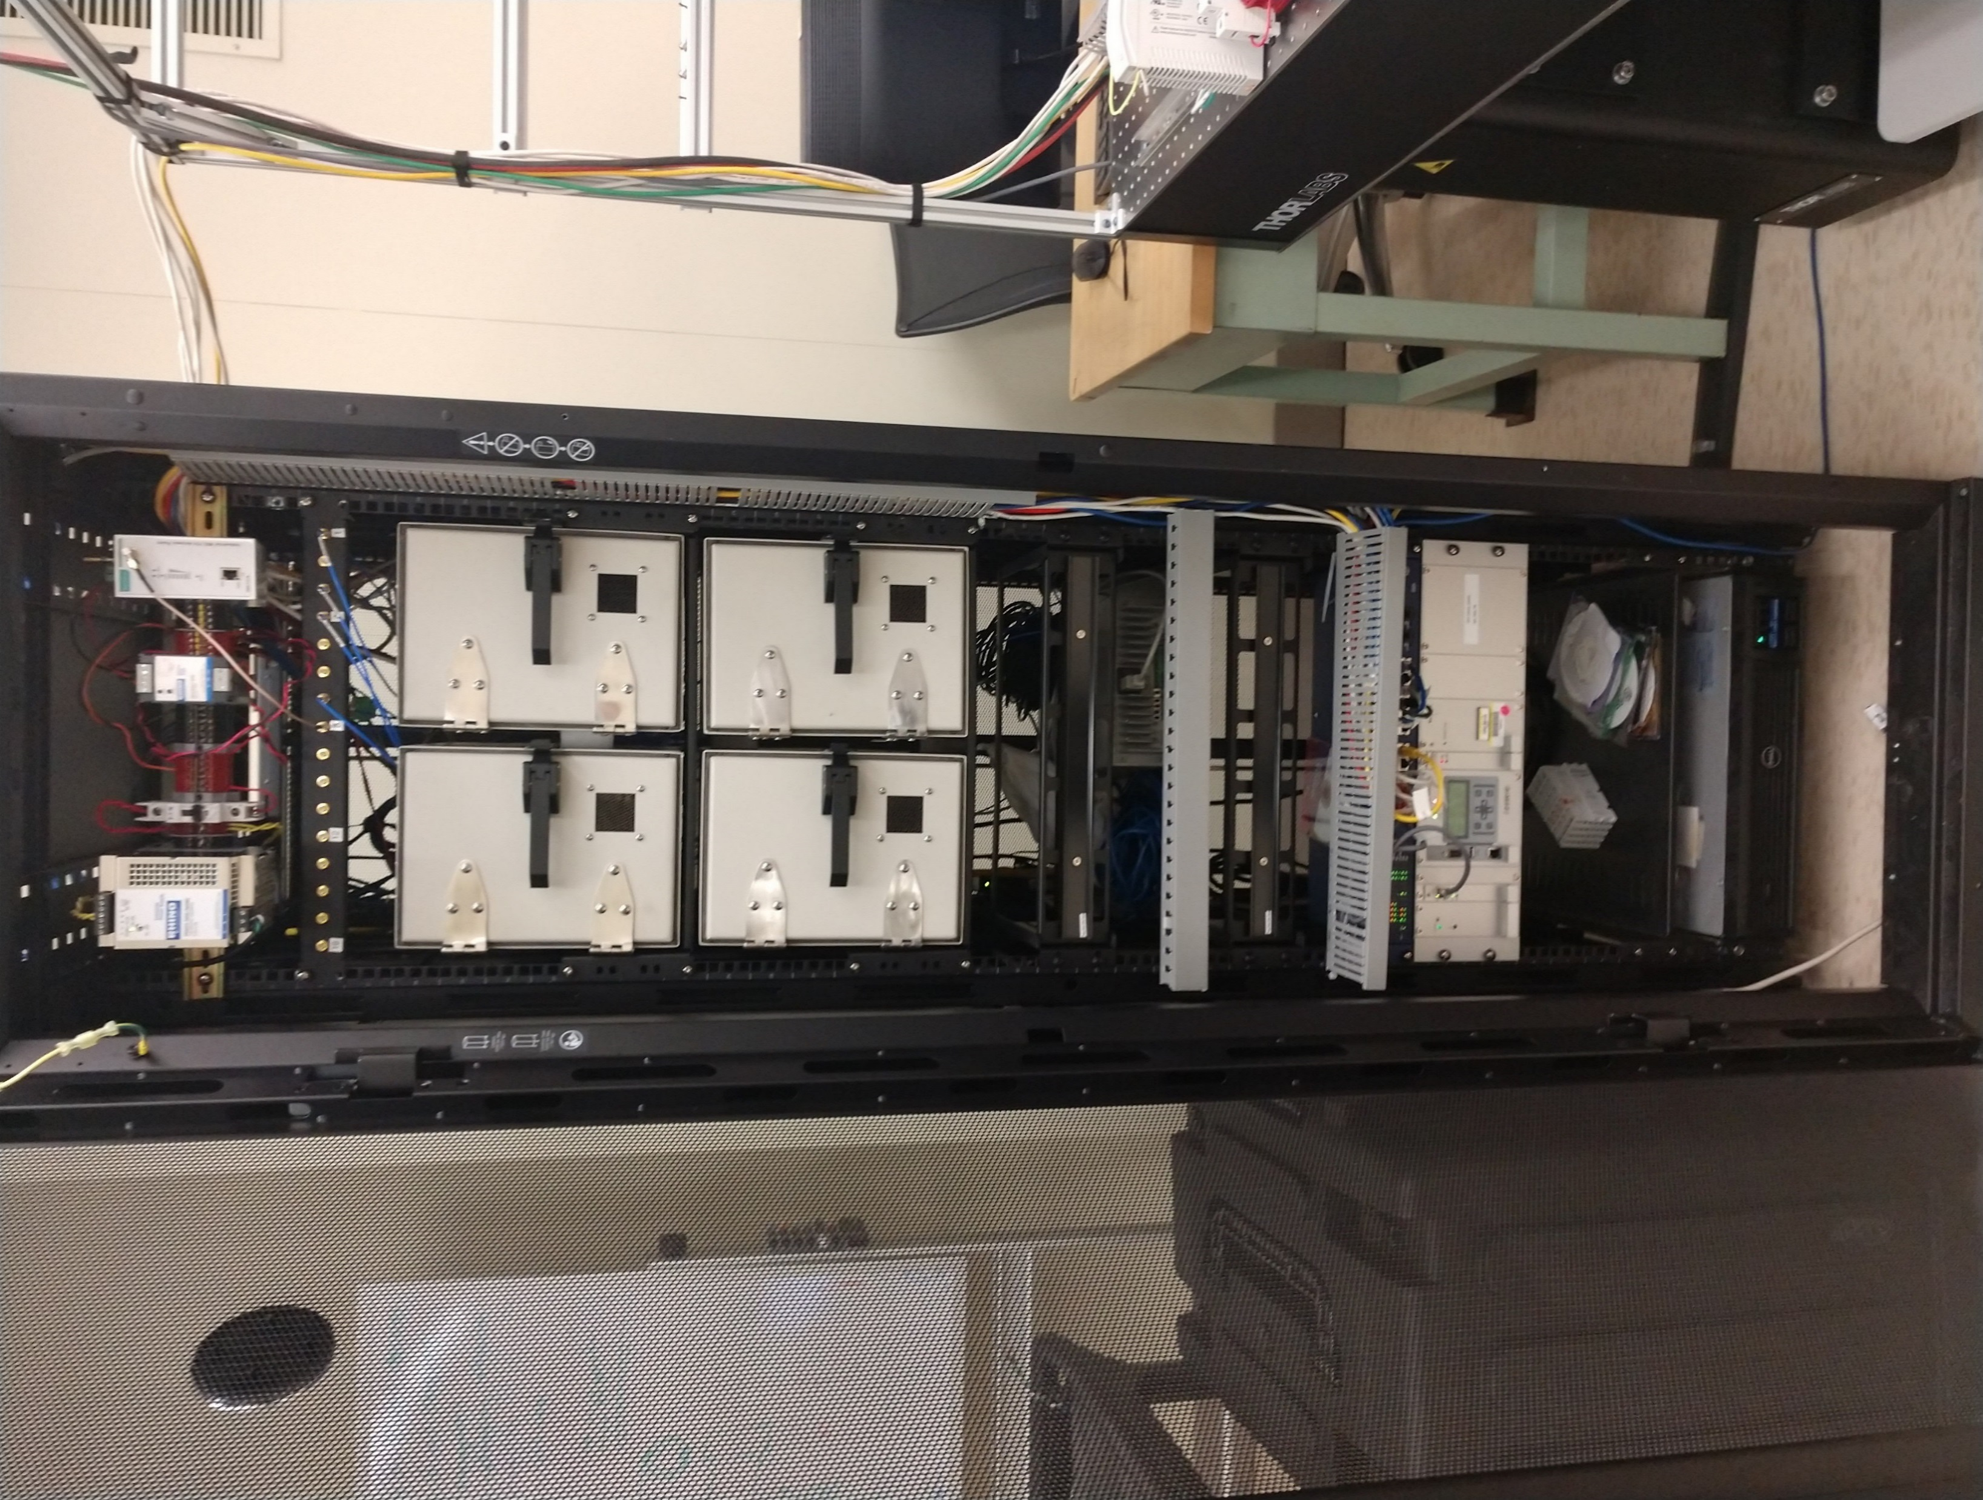
Current Demonstration Platform
Dual Cobots
RF
Shielding
CNC Sims
Supervisor
IEEE 1588 Master
RF Channel Emulator
TSN Capable

Slide 15
Thesis
Performance Estimation, Testing, and Control of Cyber-Physical Systems Employing Non-Ideal Communications Networks
Thesis Presentation 28 September 2020
Richard Candell

Slide 16
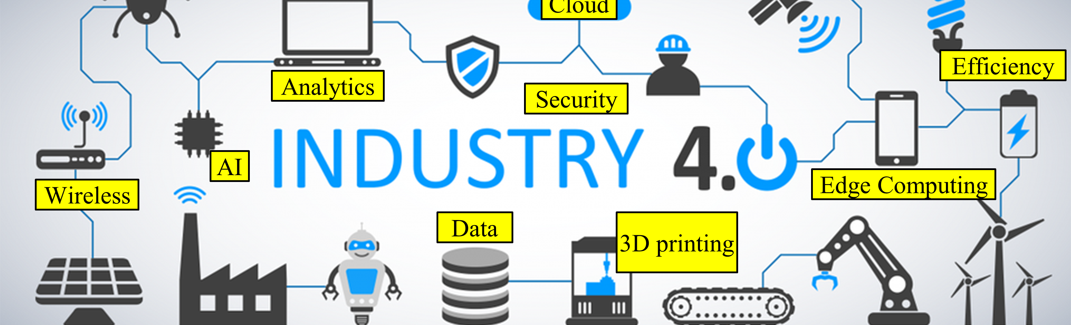
Thesis Motivation
Discover practical test and evaluation methods for assessing performance of an industrial workcell thereby helping control systems implementers to improve security, safety, and reliability.

Slide 17
Research Objectives
Exploration of Requirements:
Understand industrial wireless user requirements space
Remove hype due to marketplace and speculation
Provide validated requirements
Architectural Decomposition:
Decompose the factory workcell into components, interfaces, and information flows
Identify constraints affecting cyberphysical performance
Make the resulting finding reusable and publicly accessible
Discovery by Prototyping:
Use data from real-world experiments to drive research
Non-traditional Analysis:
Apply learning algorithms to explore data resulting from experimentation
Produce novel methods that can help identify problems during operation
Notes:
Exploration of Requirements: Industrial applications vary widely depending on the needs of the application. Applications may range from Condition Monitoring (CM) in which the required reliability and tolerable latency is high to applications such as hard real-time applications for safety integrated systems (SIS) in which reliability and latency are strictly controlled. Much of the information regarding communications requirements of these widely varying applications are based on opinion with little validation specified. Moreover, the information found can be confused by media hype and speculation. Therefore, a very important and first step in the research was to explore the requirements as stated by reputable sources such as international standards organizations and peer-reviewed papers and provide a distilled, realistic perspective uncluttered by hype and supported by experimental data or analysis of the underlying use cases.
Architectural Decomposition: The next important element within the research was to understand the composition of a factory workcell to include its constituent parts and interfaces. The goal in doing so was to discover and model the important CPS elements of a factory workcell and how those elements connect, interrelate, and conduct information in a general sense. Therefore, our objective was to create a reusable exploratory model of the CPS that is a factory workcell in which wireless communication is the primary mode of communication.
Discovery by Prototyping: During the discover process of the research work, we aimed to perform our research using real-world data from physical experiments. Since the required resources were available and at our disposal, our research objective was to conduct as much of the research using actual devices such as industrial automation and communication equipment as possible.
Non-traditional Analysis: Our final goal was to explore through experimentation the use of new data organization methods and learning approaches to analyze data taken from laboratory experiments. Therefore, our research objective was to apply database technology and machine learning algorithms in ways that had not yet been adopted or used for analysis of CPS performance analysis.

Slide 18
Contributions
Requirements [1]–[4] An examination of the wireless technology landscape is conducted. Existing and future wireless technologies are assessed for their appropriate applicability to industrial use cases.
Modeling [5], [6] In an effort to better understand the architectural composition of the workcell using industrial wireless communication, modeling techniques are used to identify and decomposed the parts, interfaces, and data flows. SysML is adopted for this process and a proposed modeling library is created and presented. The model with conceptual diagram is made publicly available independent of the tool that was used to create the model.
Application of Graph Databases [7], [8] A method is developed for collecting, cleaning, organizing, and presenting the cyberphysical performance indicators of experiments run within the NIST Industrial Wireless Testbed. The method developed utilizes the Neo4j graph database and is presented as a novel approach as compared to traditional approaches using relational database, spreadsheets, and raw file processing.
Machine Learning [9], [10] A machine learning technique is developed and applied to the prediction of signal-to-interference levels within a wireless factory workcell network employing a robot arm within a force-seeking apparatus. The machine learning method allows a trained network to accurately determine the signal-to-interference level using the physical state of the robot arm rather than the state of the wireless link itself.
Notes:
Requirements [1]–[4] An examination of the wireless technology landscape is conducted. Existing and future wireless technologies are assessed for their appropriate applicability to industrial use cases.
Modeling [5], [6] In an effort to better understand the architectural composition of the workcell using industrial wireless communication, modeling techniques are used to identify and decomposed the parts, interfaces, and data flows. SysML is adopted for this process and a proposed modeling library is created and presented. The model with conceptual diagram is made publicly available independent of the tool that was used to create the model.
Application of Graph Databases [7], [8] A method is developed for collecting, cleaning, organizing, and presenting the cyberphysical performance indicators of experiments run within the NIST Industrial Wireless Testbed. The method developed utilizes the Neo4j graph database and is presented as a novel approach as compared to traditional approaches using relational database, spreadsheets, and raw file processing.
Machine Learning [9], [10] A machine learning technique is developed and applied to the prediction of signal-to-interference levels within a wireless factory workcell network employing a robot arm within a force-seeking apparatus. The machine learning method allows a trained network to accurately determine the signal-to-interference level using the physical state of the robot arm rather than the state of the wireless link itself.

Slide 19
Publication List
[1] R. Candell and M. Kashef, “Industrial wireless: Problem space, success considerations, technologies, and future direction,” in 2017 Resilience Week (RWS), Sep. 2017, pp. 133–139, doi: 10.1109/RWEEK.2017.8088661.
[2] K. Montgomery, R. Candell, Y. Liu, and M. Hany, “Wireless User Requirements for the Factory Work-cell,” 2019. doi: https://doi.org/10.6028/NIST.AMS.300-8.
[3] R. Candell, M. Kashef, Y. Liu, K. B. Lee, and S. Foufou, “Industrial Wireless Systems Guidelines: Practical Considerations and Deployment Life Cycle,” IEEE Ind. Electron. Mag., vol. 12, no. 4, pp. 6–17, 2018.
[4] R. Candell, M. Hany, K. B. Lee, Y. Liu, J. Quimby, and K. Remley, “Guide to industrial wireless systems deployments,” Gaithersburg, MD, Apr. 2018. doi: 10.6028/NIST.AMS.300-4.
[5] R. Candell, M. Kashef, Y. Liu, and S. Foufou, “A SysML representation of the wireless factory work cell,” Int. J. Adv. Manuf. Technol., vol. 104, no. 1–4, pp. 119–140, Sep. 2019, doi: 10.1007/s00170-019-03629-x.
[6] R. Candell, “A Model of a Wireless Factory Work-Cell Using the Systems Modeling Language,” J. Res. Natl. Inst. Stand. Technol., vol. 123, p. 123018, Oct. 2018, doi: 10.6028/jres.123.018.

Slide 20
Publication List (2)
[7] R. Candell, M. Kashef, Y. Liu, K. Montgomery, and S. Foufou, “A Graph Database Approach to Wireless IIoT Work-cell Performance Evaluation,” in Proceedings of the 2020 IEEE International Conference on Industrial Technology, Feb. 2020.
[8] M. Kashef, Y. Liu, K. Montgomery, and R. Candell, “Wireless Cyber-Physical Systems Performance Evaluation through a Graph Database Approach,” J. Comput. Inf. Sci. Eng., pp. 1–19, 2020, doi: 10.1115/1.4048205.
[9] R. Candell, K. Montgomery, M. Kashef, Y. Liu, and S. Foufou, “Wireless Interference Estimation Using Machine Learning in a Robotic Force-Seeking Scenario,” in 2019 IEEE 28th International Symposium on Industrial Electronics (ISIE), Jun. 2019, pp. 1334–1341, doi: 10.1109/ISIE.2019.8781418.
[10] R. Candell, K. Montgomery, M. Kashef, Y. Liu, and S. Foufou, “Machine Learning Based Wireless Interference Estimation in a Robotic Force-Seeking Application,” ISA Trans., 2020, doi: pending.
[11] R. Candell and S. Foufou, “Smart Manufacturing Testbed for the Advancement of Wireless Adoption in the Factory,” in Proceedings of the 17th International Conference on Product Lifecycle, 2020, [Online]. Available: https://www.plm-conference.org/.
[12] M. Kashef, R. Candell, and S. Foufou, “On the Impact of Wireless Communications on Controlling a Two-Dimensional Gantry System,” in ASME 2019 14th International Manufacturing Science and Engineering Conference, 2019, vol. Volume 1:, doi: 10.1115/MSEC2019-2896.

Slide 21
Introduction to Cyberphysical Systems in Smart Manufacturing
Performance Estimation, Testing, and Control of Cyber-Physical Systems Employing Non-Ideal Communications Networks
Thesis Presentation 28 September 2020
Richard Candell

Slide 22
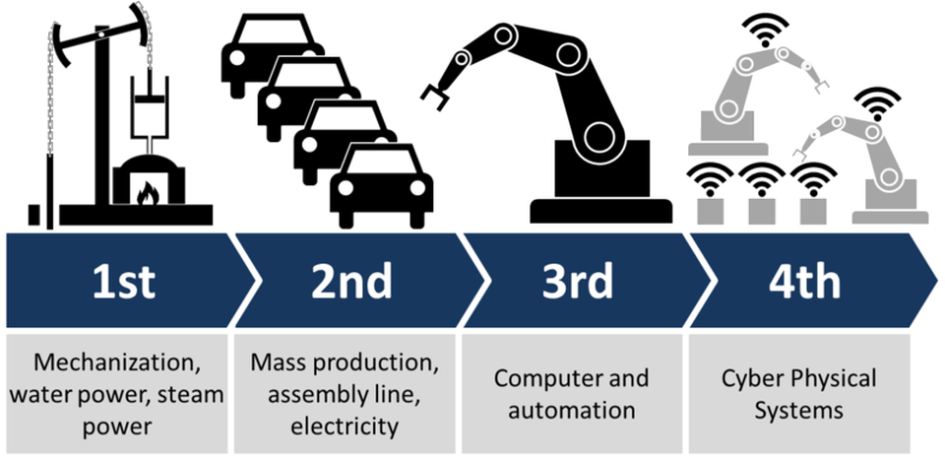
History of World Industrialization
Notes:
There have been four major industrial revolutions since industrialization began more than 200 years ago.
Gen 1: Steam engines powered by coal - late 1700’s
Gen 2: Powered by electricity and manned by people - late 1800’s
Gen 3: Computers are added to automate most of the process - later part of 1900’s
Gen 4: Use of data and intelligence to improve agility of the process – ENTER the CPS - 2000’s and today

Slide 23
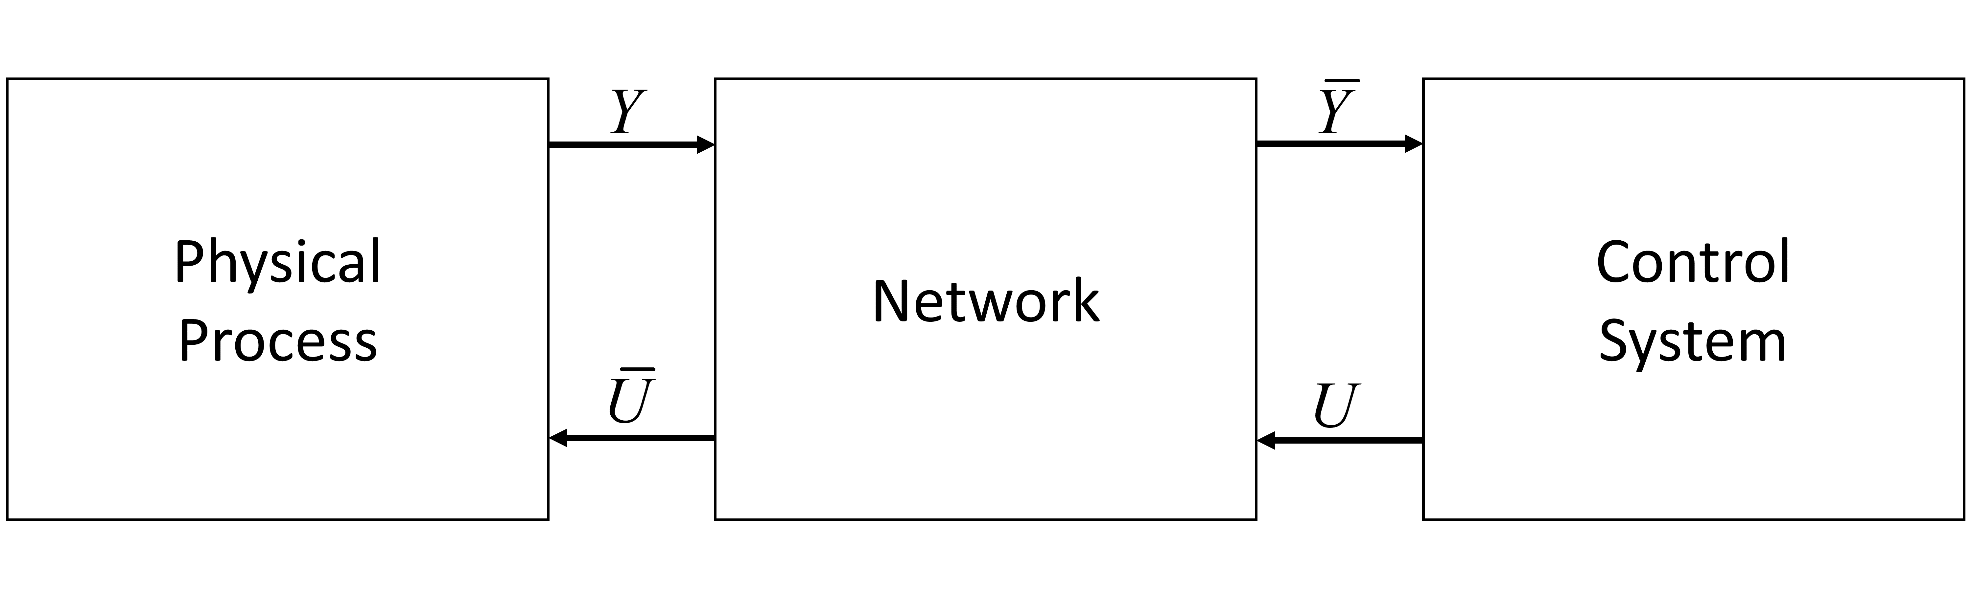
What is a Cyberphysical System? (CPS)
Operational Technology (OT)
Information Technology (IT)
Notes:
Definition most applicable for this thesis: A CPS is a physical process that is highly connected through computing devices such as sensors, actuators, and controllers.
A cyberphysical system (CPS) is a computer system in which a mechanism is controlled or monitored by computer-based algorithms. In cyber-physical systems, physical and software components are deeply intertwined, able to operate on different spatial and temporal scales, exhibit multiple and distinct behavioral modalities, and interact with each other in ways that change with context.^{[1]} Examples of CPS include smart grid, autonomous automobile systems, medical monitoring, industrial control systems, robotics systems, and automatic pilot avionics.^{[2]}

Slide 24
CPS Concepts in Smart Manufacturing
Situationally-aware and state-aware automation systems
Move intelligence closer to the edge devices (or in the devices)
Better test methods that include holistic perspective
Better communications protocols (esp. for wireless)
Requires high reliability and security
Notes:
The automation system must become state aware and adaptive to knowledge of the trends in electromagnetic spectrum occupancy and acute events;
Intelligence of the automation system must move closer to the physical system. This means moving the intelligence for control to the actuator; and
Performance test methods must be developed and incorporated into the industrial fringe devices. The test methods must be dependable and at the same time easy to use by factory personal not trained in the technicalities of wireless communication.
Existing Wireless communications protocols must be analyzed and adapted, and new protocols must be developed to balance reliability, latency, and scalability.
Security of the network must be maintained and must include availability as a paramount characteristic.

Slide 25
Industrial Wireless Requirements
Performance Estimation, Testing, and Control of Cyber-Physical Systems Employing Non-Ideal Communications Networks
Thesis Presentation 28 September 2020
Richard Candell

Slide 26
Research Objectives
Better understand the landscape of wireless within industrial systems
Create a mapping of use case classes to wireless technologies
Encourage discussion of wireless solutions in industrial systems

Slide 27
Mapping Wireless to Automation Systems
Flow-based
Job-based
Safety
Back-haul
Tracking
Security
Remote Control
Maintenance
Notes:
Considered many different types of industrial use cases
Considered how each wireless technology could be applied, if they could be applied and to what degree
Used literature to support our claims.

Slide 28
SysML: Workcell Architectural Decomposition and Analysis
Performance Estimation, Testing, and Control of Cyber-Physical Systems Employing Non-Ideal Communications Networks
Thesis Presentation 28 September 2020
Richard Candell

Slide 29
Modeling Objectives
Decompose the industrial wireless workcell into:
Constituent components
Identify interfaces
Identify information flows
Identify constraints to performance
Construct a re-usable model for other researchers
Help improve the understanding of the industrial wireless workcell
Communicate designs more effectively
Make model publicly available

Slide 30
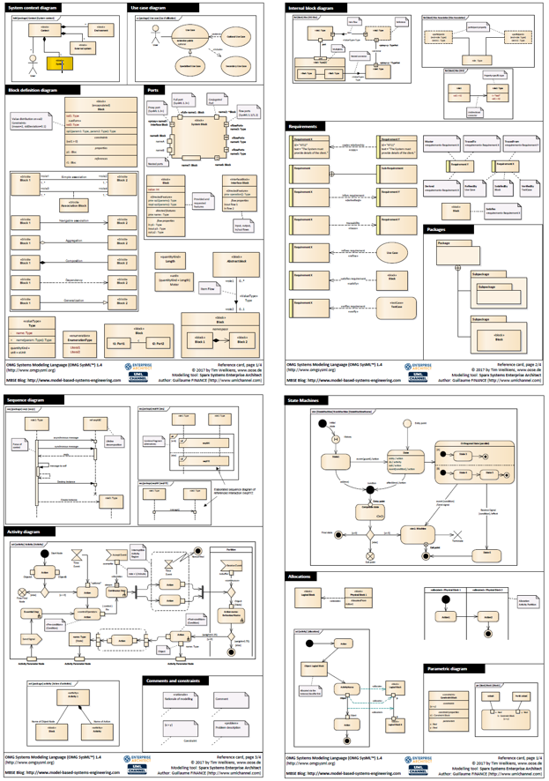
SysML Primer
SysML Components
Blocks, Ports, Connections, Associations
Popularly Used Diagrams
Block Definition Diagrams (BDD)
Internal Block Diagram (IBD)
Parametric diagram (PAR)
Use case diagram (UC)
Requirements diagram (REQ)
Package diagram (PKG)
Other diagrams
Reference card taken from:
https://community.sparxsystems.com/community-resources/1043-sysml-1-4-reference-card
Notes:
BDD – shows context and decomposition
IBD – shows the internal construction of a block
PAR – shows how a block is parameterized or constrained by values, equations, and logic (programs)
UC – shows use cases of a system
REQ – captures requirements
PKG – Shows package organization
Other diagrams include
Sequence diagrams
Activity Diagrams
State machines

Slide 31
Conceptual Diagram
Device
Wireless Device
Controller
Controller
Robot Controller
PLC (Controller)
Applications
IWN
Radio Channel
Service
Constraints
Notes:
Applications are contained within a Device to describe its use and contain programs

Slide 32
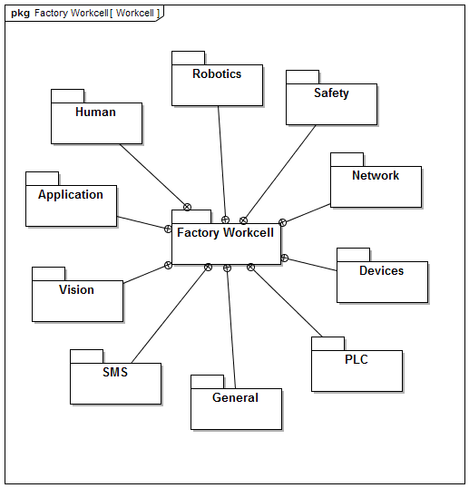
Packages
General: contains key reusable blocks for constructing other packages
Devices: describes the generic device blocks within the model
Network: describes the generic industrial network
Robotics
PLC: Programmable Logic Controller
Safety
SMS: Spectrum Monitoring System
Notes:
SMS is a key component of any industrial wireless deployment

Slide 33
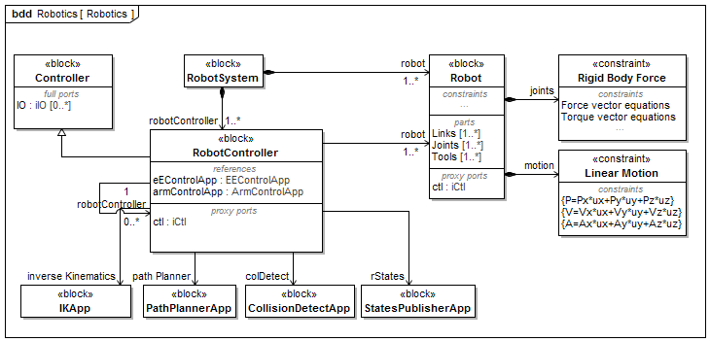
Robotics

Slide 34
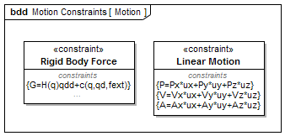
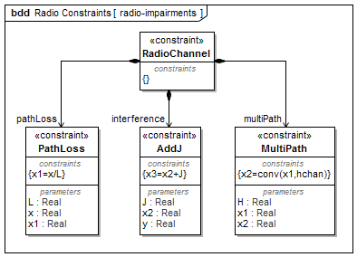
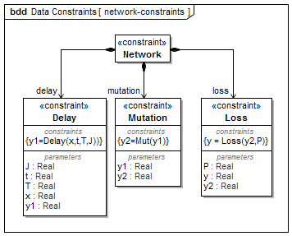
Constraints
Allows us to model mathematically or programmatically effects of behavior within a block.

Slide 35
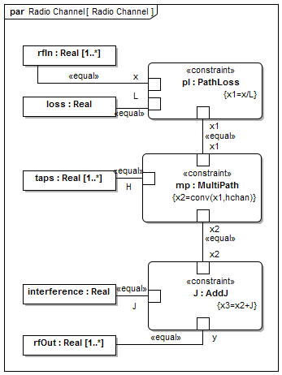
Radio Channel Constraints

Slide 36
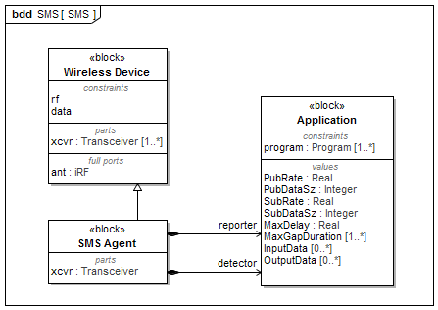
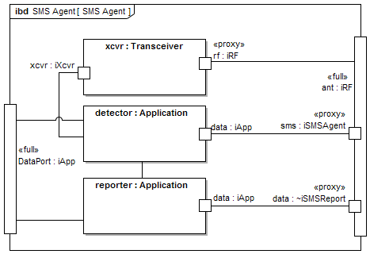
Spectrum Monitoring System (SMS)

Slide 37
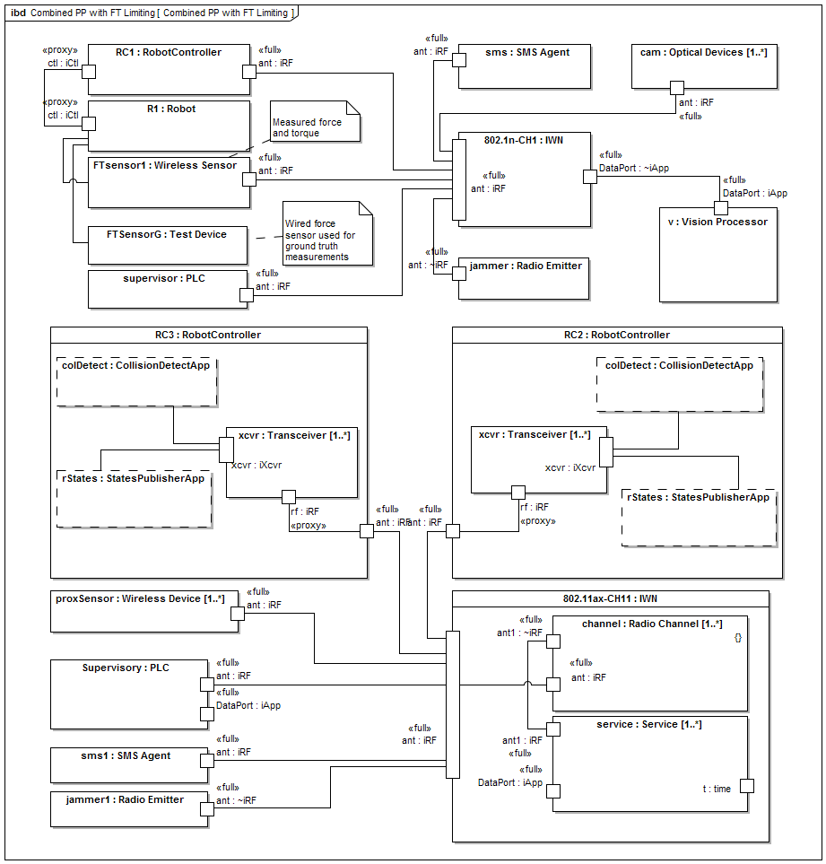
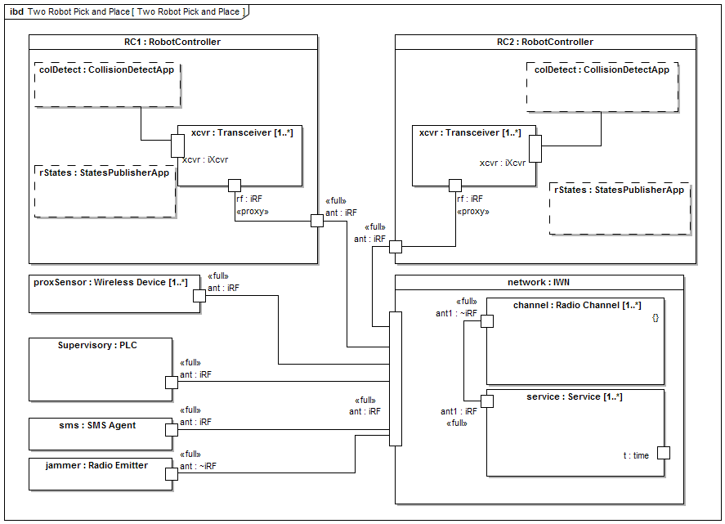
Example IBDs of Factory Workcells

Slide 38
Application of the Graph Databases to CPS Experiments
Performance Estimation, Testing, and Control of Cyber-Physical Systems Employing Non-Ideal Communications Networks
Richard Candell

Slide 39
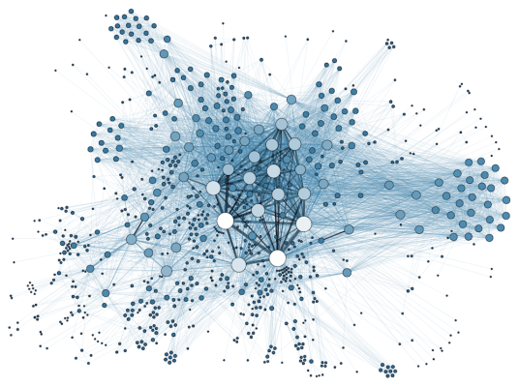
Introduction & Motivation
Motivation:
Address the difficulty of organizing IT and OT data and their correlated relationships
Graph Database Advantages
Inherently capture data and relationships
No need to perform complex joins
Outputs
Used the GDB to study the impacts of the IWN on the physical system
Notes:
Lots of data from experiments:
GBs of data from a single experiment
Enormous amounts of data
Need to organize the data well
Neo4J chosen:
Free – no cost
Supports Python
Good reviews - seems to be the most popular

Slide 40
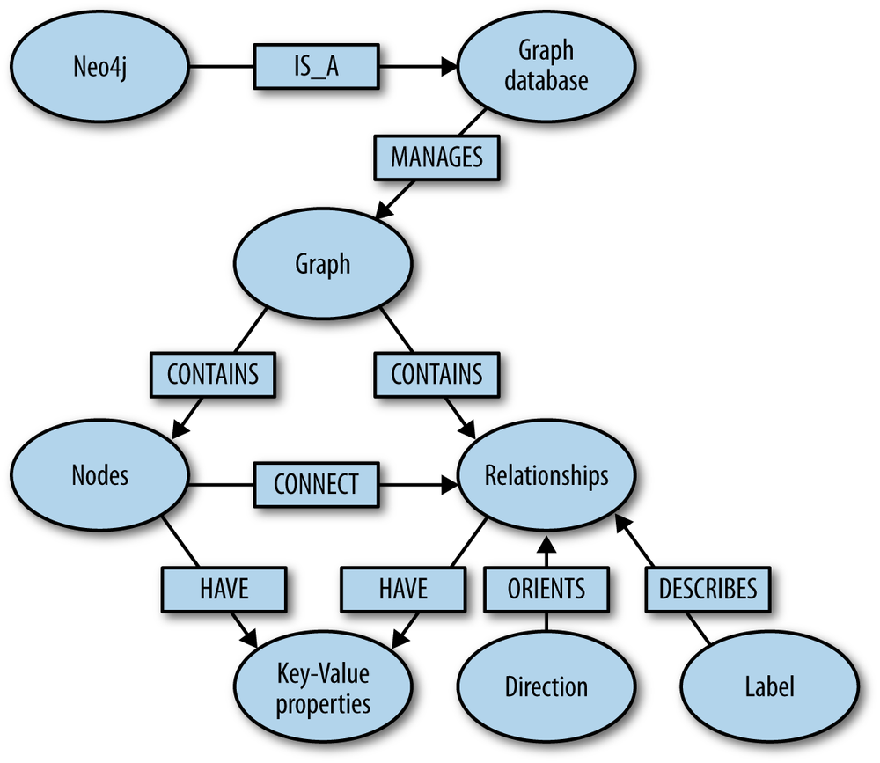
What is a Graph Database?
A graph database (GDB) is a database that uses graph structures for semantic queries with nodes, edges, and properties to represent and store data. A key concept of the system is the graph.

Slide 41
Graph Database Process Flow
Notes:
Post-import tuning: Applies the timing information of the messages with the Wi-Fi sniffer reports to connect QoS reports with the messages. This is used to form the COVERED relationship. Python was used to process the CSV export and add new relationships to the database for existing nodes.

Slide 42
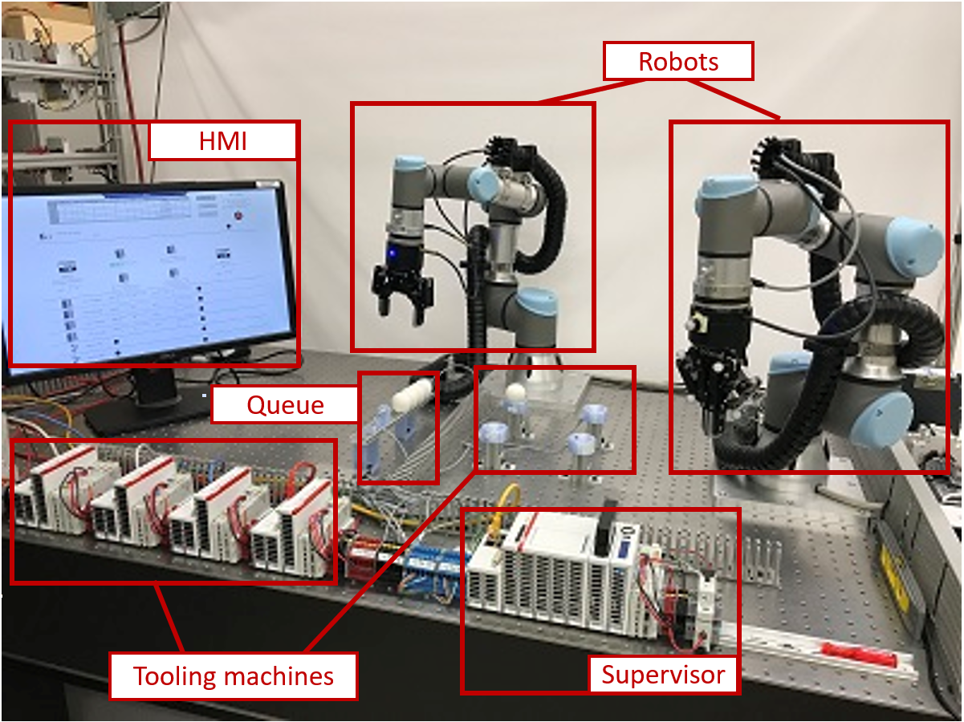
Testbed Configuration

Slide 43

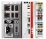
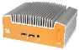
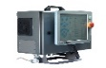
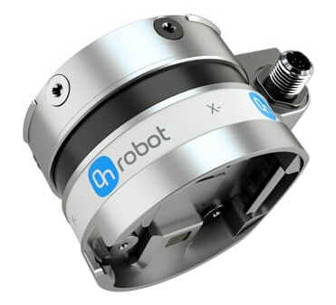
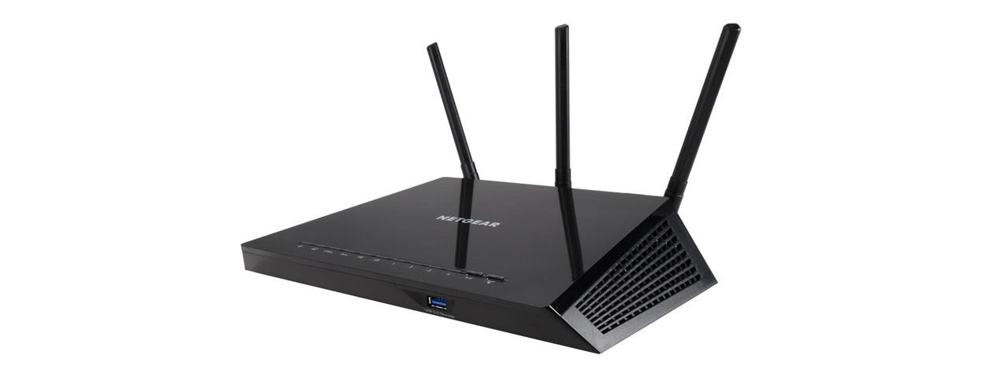
Inspector
Supervisor
NUC
INS_FT
INS_RC
TAP
Eth->Wi-fi
PLC
Two PTP capable switches
(22 ports combined)
Wi-Fi Router
Non-PTP Switch
TAP
AP
Robot Controller(RC)
Force-Torque(FT) Sensor
Operator
TAP
TAP
CNC_1
Non-PTP Switch
Eth->Wi-fi
Traffic Generator
Sniffer
Traffic Sink
TAP
CNC_2
TAP
CNC_3
OPT_FT
OPT_RC
TAP
CNC_4

Slide 44
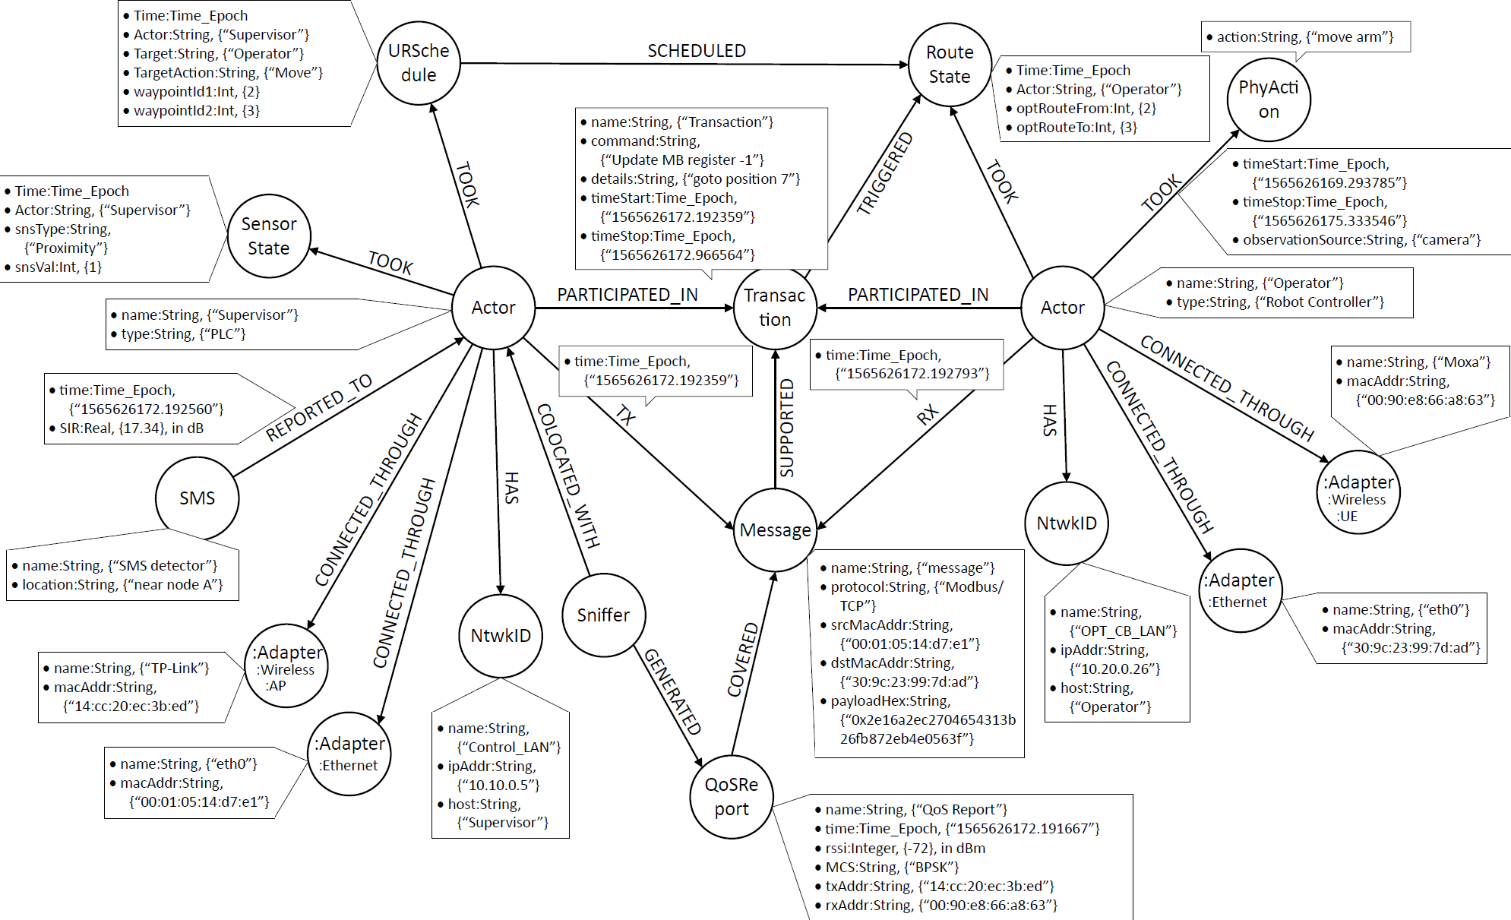
Intended Schema Design
Notes:
Done using arrow tool on Internet
Really a “pseudo-schema” showing the intended design.
Actor
Transaction
Message
Network interfaces
Physical Action
URSchedule – PLC makes a decision
Route State – UR begins the movement/action
FROM PAPER
Transaction A complete information exchange between two or more actors (multiple actors may participate in a transaction).
Message A network transmission event that occurs between two actors (messages are essentially packet transmissions captured at the transport layer; multiple messages support a transaction).
QoSReport Quality of service report of a message (not all messages will have a QoS report).
Physical Action (PhyAction) A physical occurrence within the factory work-cell associated with Actors through multiple time-based relationships.
PhyAction:URSchedule A subcategory of PhyAction representing a schedule decision made by the supervisor PLC for a robot
PhyAction:SensorState A subcategory of PhyAction representing a real-time reading of the proximity sensor state in a CNC
PhyAction:RouteState A subcategory of PhyAction representing a real-time reading of the action route in a robot

Slide 45
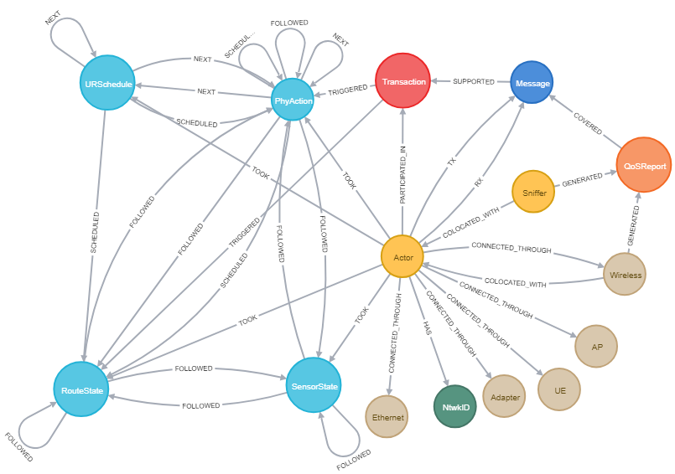
Realized schema: Only the visualization is different from designed schema
Notes:
Does not show inheritance in the realized graph.
call db.schema.visualization()
One thing that I don’t like is that it does not display the inherited node types although they do exist in the GDB, they are not shown in the visualization.

Slide 46
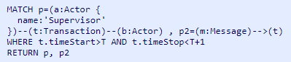
Example Query Using Cipher
This query searches for all Supervisor-based Transactions and associated Messages where the Transaction start and stop times fall within the first second of the experiment.
The query will return the Supervisor node with connected messages.

Slide 47
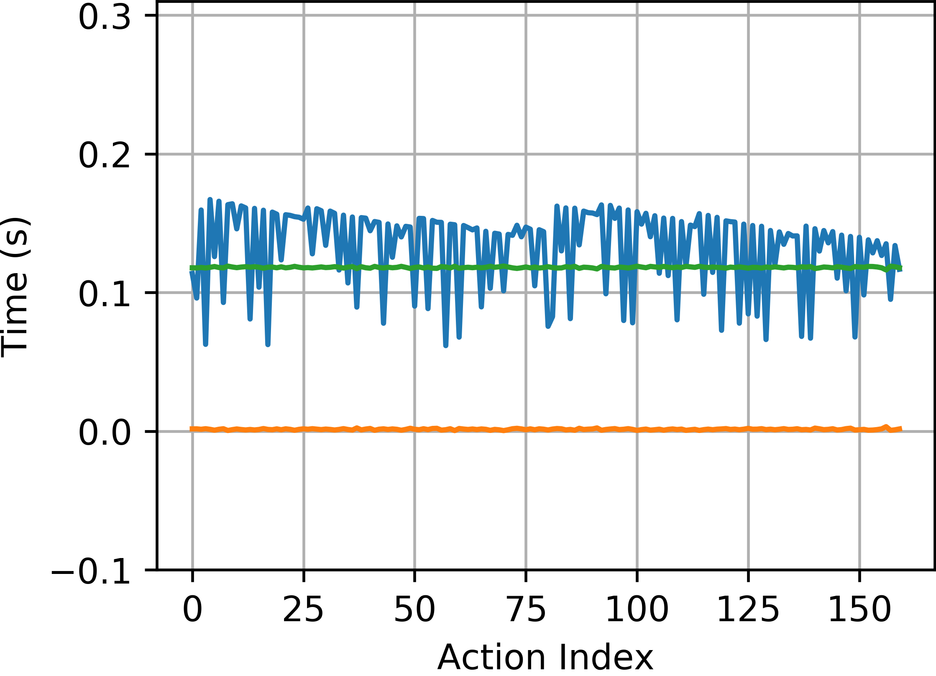
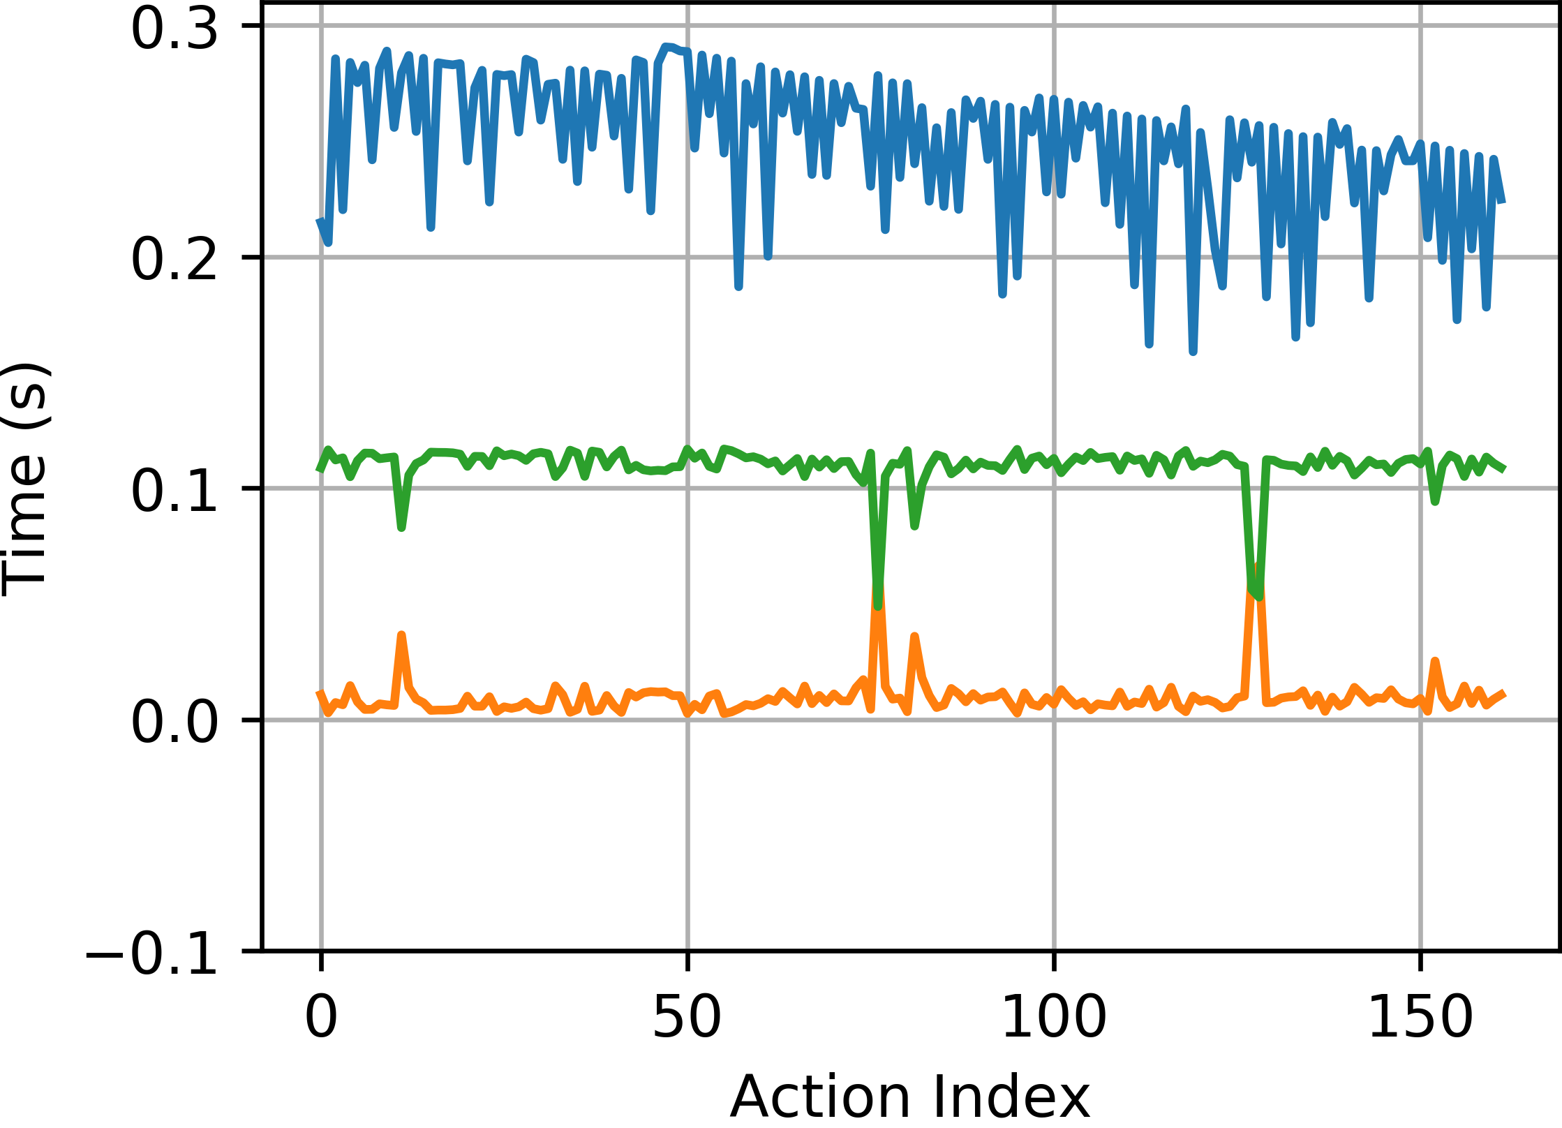
Sample Results from Query
Wired Performance Baseline
Wireless with 2-Streams Interference
Increase
Sum is Constant
The supervisor PLC processing time in blue is shown and appears to have a change in latency bias. The transaction latency in orange is clearly impacted by the wireless channel; however, the robot controller shown in green appears to compensate for transaction latency variance such that the sum of transaction latency and robot processing time remains constant. This indicates that wireless should be a good candidate for this control system as physical latencies do not increase under these scenarios.
Notes:
Blue line variation seems unconnected to the network but entirely dependent on the processing within the PLC
Orange and Green sum to be constant at 120 ms which is loop rate of the robot controller. Wait time in the robot controller included a 20 ms intrinsic loop time plus another 100 ms hard-coded wait time.
Average processing time of the PLC did increase with the wireless baseline due to a programming change to accommodate longer ADS protocol delays in communication.

Slide 48
Machine Learning in a Robotic Force Seeking Application
Performance Estimation, Testing, and Control of Cyber-Physical Systems Employing Non-Ideal Communications Networks
Thesis Presentation 28 September 2020
Richard Candell

Slide 49
Introduction and Motivation
Goals
Predict link quality indirectly using measurements of the OT (physical) system
Eliminate the expense of RF equipment for LQE measurement in the factory
Results
Measured LQE using measurements data from vision system measuring the movement of a robotic arm depressing a spring
Accuracy of LQE prediction within ±0.5 dB
Notes:
Used the Scikit-Learn Python library for implementation

Slide 50


Force seeking spring system apparatus
Robot depresses a spring until a force of 5 N is sensed
Force is monitored by a wireless force-torque sensor (FTS)
Robot Controller is wired thereby isolating the wireless component to the FTS
Emulator is used to control the effect of a local jammer
Wireless sniffer is used to monitor network traffic traversing space

Slide 51


Model of the Feedback Control System
Vision system targets

Slide 52


Depression force search model
Z-axis Movement Model
Sample Z-axis Movement

Slide 53


Learning candidacy statistics
Z_{bc} Plunge Time
Z-axis Deflection
Searching for before/after variations. The before and after variations show good candidacy for application of machine learning.

Slide 54


Feature Independence Check
Verification of non-correlation between features. Features work best in ML when they are mostly independent. A first look shows that the features are mostly independent from one another. This does not mean that each one has importance, but rather they will not interfere or be redundant.
Notes:
Zd and DeltaTbc are correlated because D = Velocity * T
Correlation of Delta-Tab and total time are strongly correlated because only Delta-Tab is most affected by SIR (later revealed in second paper due to time of zeroing).
Zeroing accomplished by messaging between RC and the Compute box to zero-out sensor. This message gets delayed by lower SIR’s.
Correlation 0 indicates not correlated
Correlation of +1 or -1 indicates a very strong correlation either positively or negatively.

Slide 55

Model for Radio Path loss and Interference Emulation
Vary distance between jammer and router
Vary distance between jammer and station
Vary the mode of the router

Slide 56
Test set prediction performance
Notes:
M is the number of cycles used for a single training record

Slide 57

Initial Results Against Segment Size, M
Notes:
Bias: Difference between the expected value of the estimates and the actual values.
MSE: Is the mean squared error
Variance: How much the estimate varies around its own expected value
Good explanation found at http://rasbt.github.io/mlxtend/user_guide/evaluate/bias_variance_decomp/#:~:text=Then%2C%20the%20bias%20is%20commonly,%5B%CB%86%CE%B8%5D%E2%88%92%CE%B8.

Slide 58
Subsequent Regressor Comparisons
Random Forest (RnF) – randomized decision regression trees are formed based on random, and a joint result from all trees are calculated. Overfitting is achieved by limiting leaves and features in each tree constructed although full coverage is guaranteed by the sheer number of trees constructed.
Gradient Boosting Machine (GBM) – Similar to RnF except that tree size is limited, and trees are iteratively made by minimizing the residual errors of the previous trees until convergence is achieved.
Extreme Gradient Boosting Machine (XGBM) – Like GBM but uses similarity score (mean sum error + regularization λ)
Linear Ridge – first-order linear regression model (as a comparison)

Slide 59
Variance and MSE of Various Regressors
Notes:
Bias: Difference between the expected value of the estimates and the actual values.
MSE: Is the mean squared error
Variance: How much the estimate varies around its own expected value

Slide 60

Comparison of Feature Importance
Using XGBM as basis
Comparison of impact of each feature one-at-a-time and then all together.
Dwell time before descent (Δt_{ab}) was found to be the most impactful feature
Due to zeroing message between robot controller and FT sensor compute box

Slide 61
Conclusions and Future Direction
Performance Estimation, Testing, and Control of Cyber-Physical Systems Employing Non-Ideal Communications Networks
Thesis Presentation 28 September 2020
Richard Candell

Slide 62
Conclusions
Requirements and wireless landscape
Surveyed the wireless technology landscape
Made the requirements realistic and validated
Modeling Approach
Produced a reusable model using SysML
Include both structure of the IWN and the Physical System
Graph Database Approach
Demonstrated use of a GDB for CPS performance evaluation
Use of GDB to reveal performance correlations between IT and OT
Machine learning approach
Use of decision trees to estimate link quality (SIR) using OT measurements

Slide 63
Future Work
SysML
Modeling Enhancements
Integration with CPS simulation
Graph Database
Make the GDB real-time or near-real-time with on-the-go queries
Improve the GDB Schema to avoid Cartesian Product explosions
Machine Learning
Increase dimensionality of the machine learning approach to address considerations of larger systems and concerns
Integrate the machine learning approach with a control system to allow the control system to adapt to changes in the RF environment
Add spectrum monitoring system as an input to the machine learner
Notes:
SysML Modeling Enhancements Application of the model described may be improved upon and incorporated into \gls{cps} simulations. By using the model and associated constraints, it should be possible to use the blocks defined to parameterize the simulation variables. Additionally, moving beyond simulation which uses simulation to understand complex systems through empirical analysis, complete mathematical analytical models could be constructed if the fidelity of the \gls{sysml} model is sufficiently refined.
GDB Real-time Integrations A logical next step in applying \glspl{gdb} to \glspl{cps} is to move its application from a post-experiment analysis to a real-time analysis of a live system. Such an analysis could prove insightful in the prediction of factory workcell performance at near-real-time. Parallel data collection, cleaning, and insertion strategies could be considered. Further integration and feedback into the production system of information learned from real-time queries is possible to improve overall live performance of the factory.
GDB Schema Improvements During the experimentation with the Cipher query language, we found that some queries led to unusually large and intractable intermediate result sets which resulted in a computer crash regardless of the organization of the query statements themselves. This problem resulted from a Cartesian product explosion that was never sufficiently explained such that a resolution could be implemented. It was not clear if this was a result of normalization of the query within the Cipher interpreter or a result of the schema that we developed. Reorganization of our queries did not help to alleviate this problem which ultimately limited the usefulness of the \gls{gdb}. The use of \glspl{gdb} was nevertheless proven as it was an essential aid in organization of our very large \gls{cps} data sets produced from experimentation. For a scientist interested in such deep-dive questions related to database query languages or schema development, this would be an interesting problem.
ML Add More Dimensions Application of our ML framework to a system with more degrees of freedom such as the entire workcell. In our contributions, the ML framework was applied to a single wireless communication link used to control one robot arm. When expanded the framework to systems with more dimensions, the application of neural networks with deep learning may be beneficial.
Apply ML to Spectrum Monitoring System] Application of online learning techniques such that our ML framework can learn and adapt as the workcell operates would be beneficial as well. In the current contribution, the ML framework learns offline from training data and then applies its knowledge to an active system. This prohibits the system from learning as the wireless network changes over time. Online techniques could allow for the ML framework to account for a changing spectral environment.
Integrate ML with the Control System] Integration of our \gls{ml} framework with the workcell control system such that the control system can adapt dynamically to interference for example to allow the control system to task preventative actions for safety or to operate in a reduced performance mode.

Slide 64


Slide 65




MSE is mean of squared errors between estimate and actual value

